Slide 1
When the Universe is
Your Infrastructure
Orchestrating a Semi-Autonomous Astronomical Observatory with
Nagios XI, Alexa, Smart IoT Integration, and Real-Time Monitoring
Eric Loyd | The Astropotamus | https://astropotamus.com

Slide 2
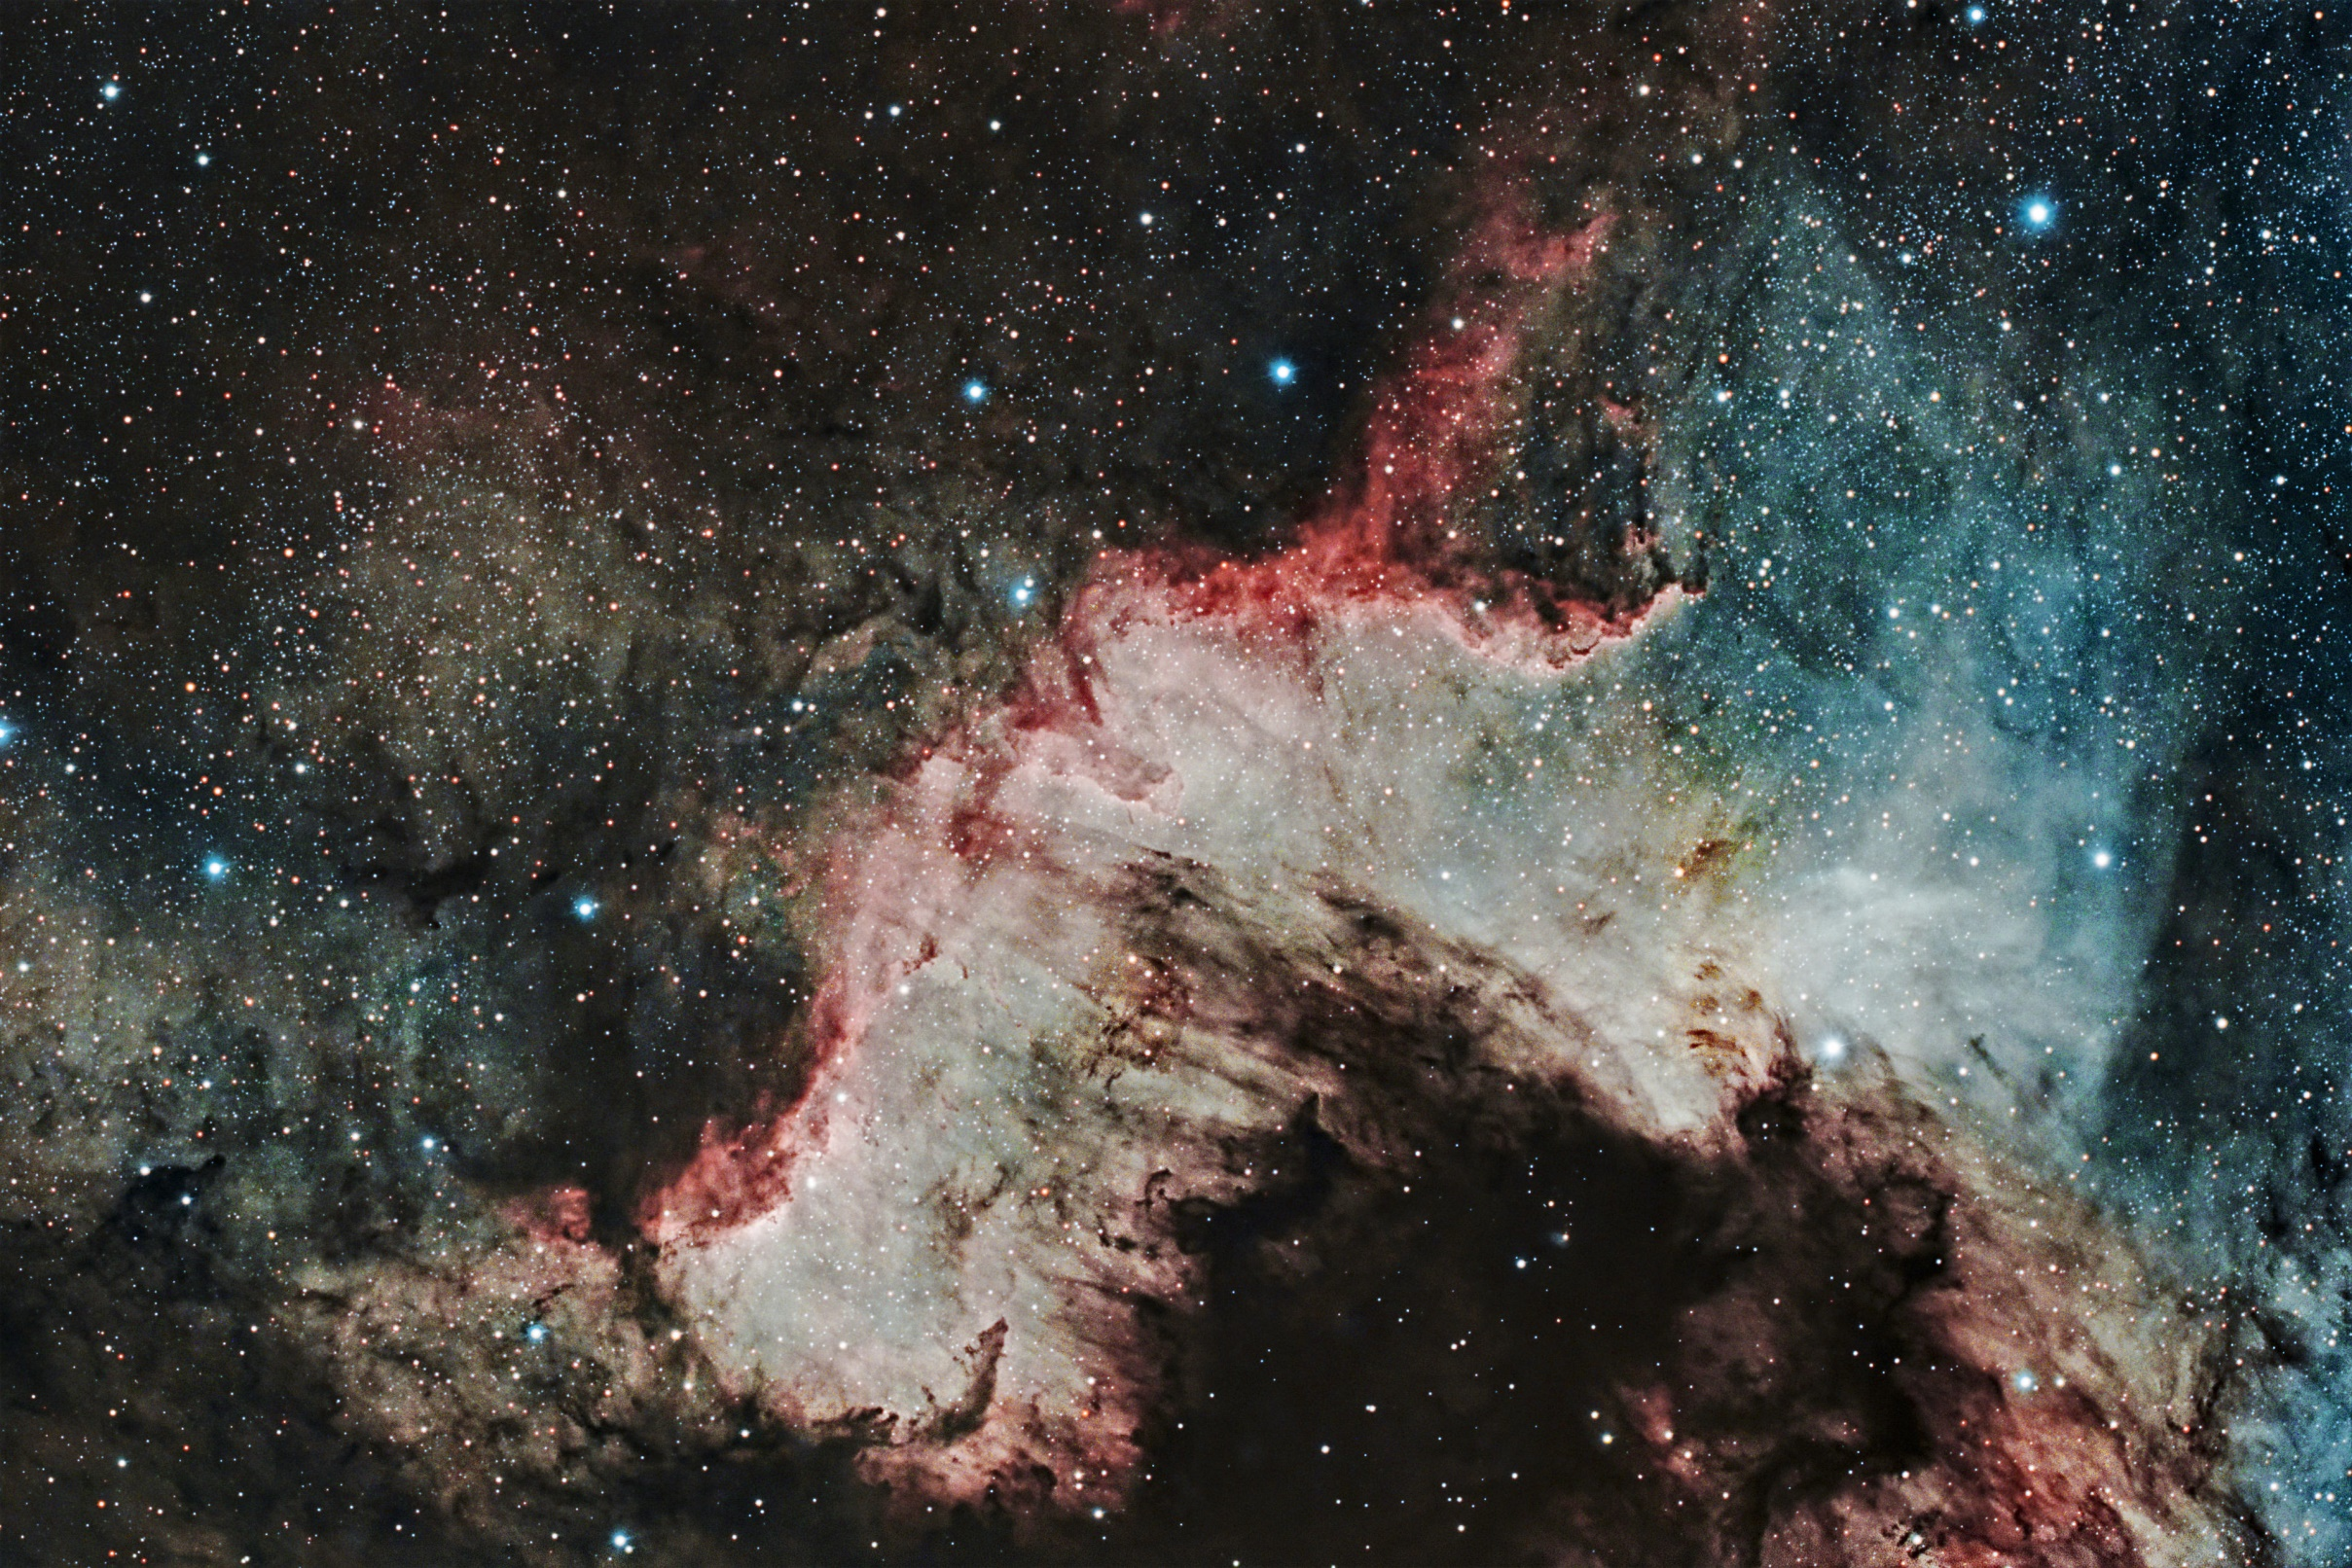
The Cygnus Wall

Slide 3
What is an AstropotaPOD?
A semi-autonomous backyard observatory protecting precision astrophotography gear under an open sky.
Okay, but why is it called the AstropotaPOD?
Notes:
So what is an AstropotaPOD? It’s my semi-autonomous backyard observatory, designed to protect about a hundred pounds of precision astrophotography gear worth tens fo thousands of dollars, all while operating unattended under an open sky.

Slide 4
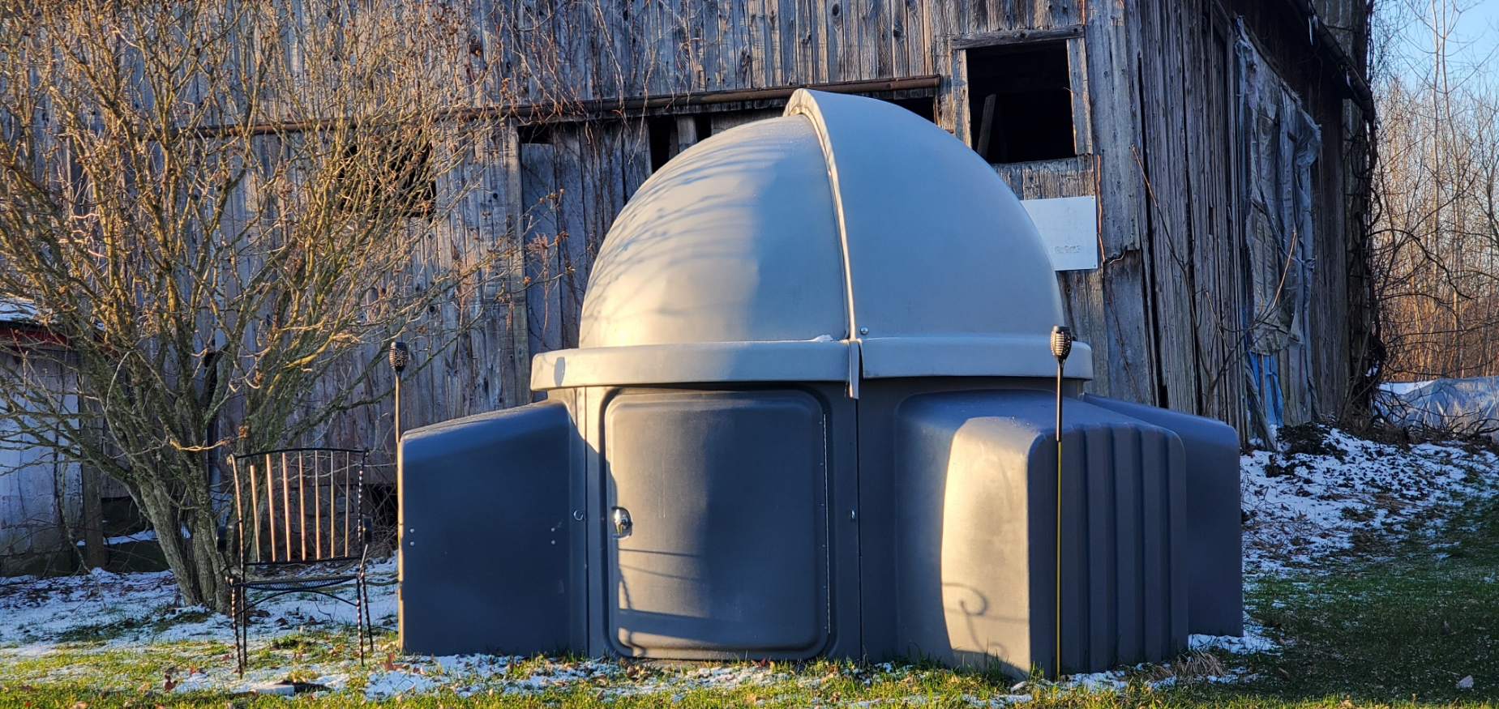
The
Operational
Challenge
Protecting precision electronics when physical automation isn't an option.
Manual Structure
No motorized roof mechanism; opening and closing the observatory requires physical human intervention.
Microclimate Volatility
Pop-up rain, sudden dew point shifts, and high winds develop faster than official regional forecasts update.
Sensitive Payload
Mini-PCs, 12V power distribution, cooling fans, focus motors, and sensitive electronics that cannot survive rain or a lightning strike
Notes:
The gear itself: cooled cameras, motorized mounts, optical tubes, is engineered to collect light for hours without human intervention. But the physical observatory structure has a big constraint: a completely manually operated half-dome, clamshell lid.

Slide 5
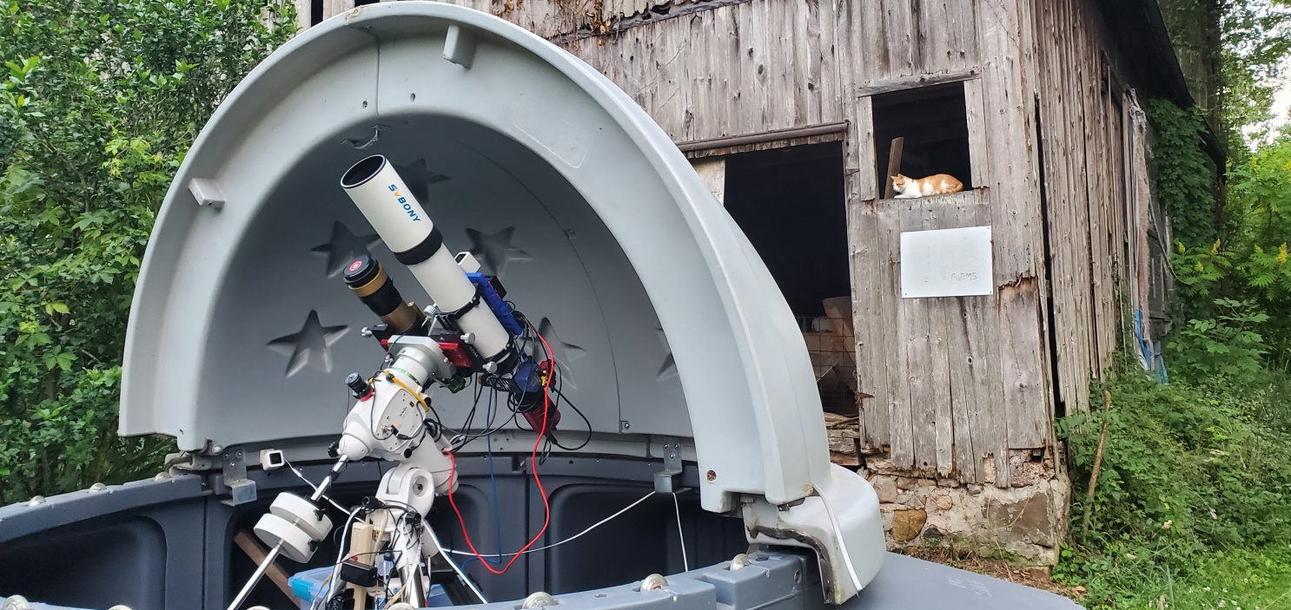
The
Monitoring
Requirements
I want to know if I need to rush out to close the POD only if I’m imaging. Otherwise, I assume the POD is closed and I don’t care.
Zero Sleep-Disrupting False Alarms
Passing clouds or light humidity shouldn't wake me up at 2:00 AM. Rain should.
State-Aware Intelligence
The system must know whether I'm actually imaging with the roof open, or if the gear is safely parked and covered.
Unavoidable Physical Escalation:
If a real threat hits, a phone notification isn't enough; I need audio, visual, and priority smart-home alarms to get me outside fast.

Slide 6
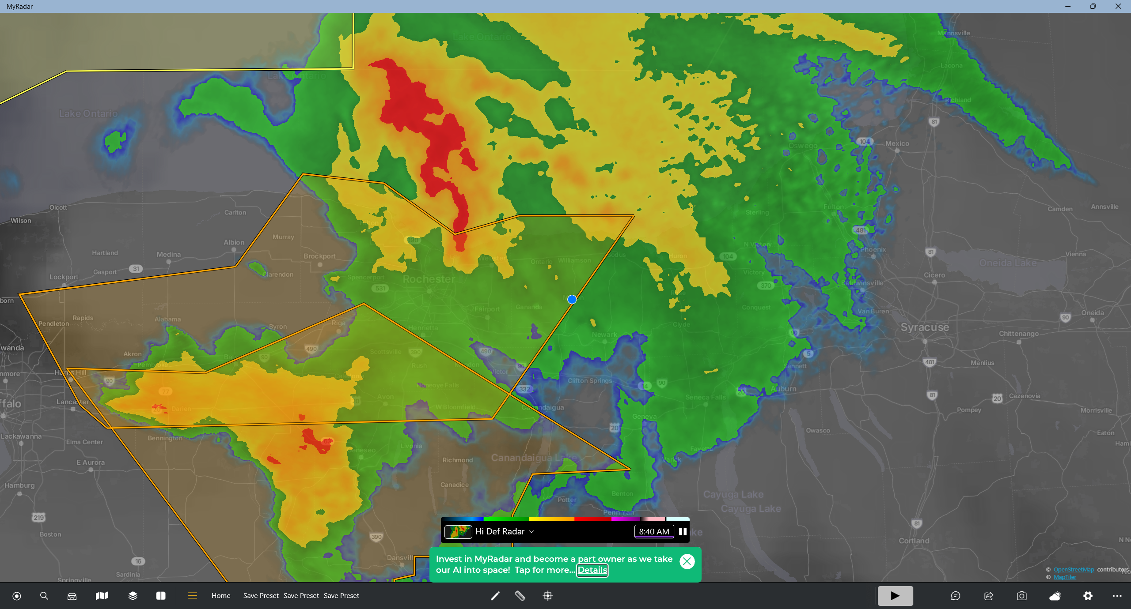

Slide 7
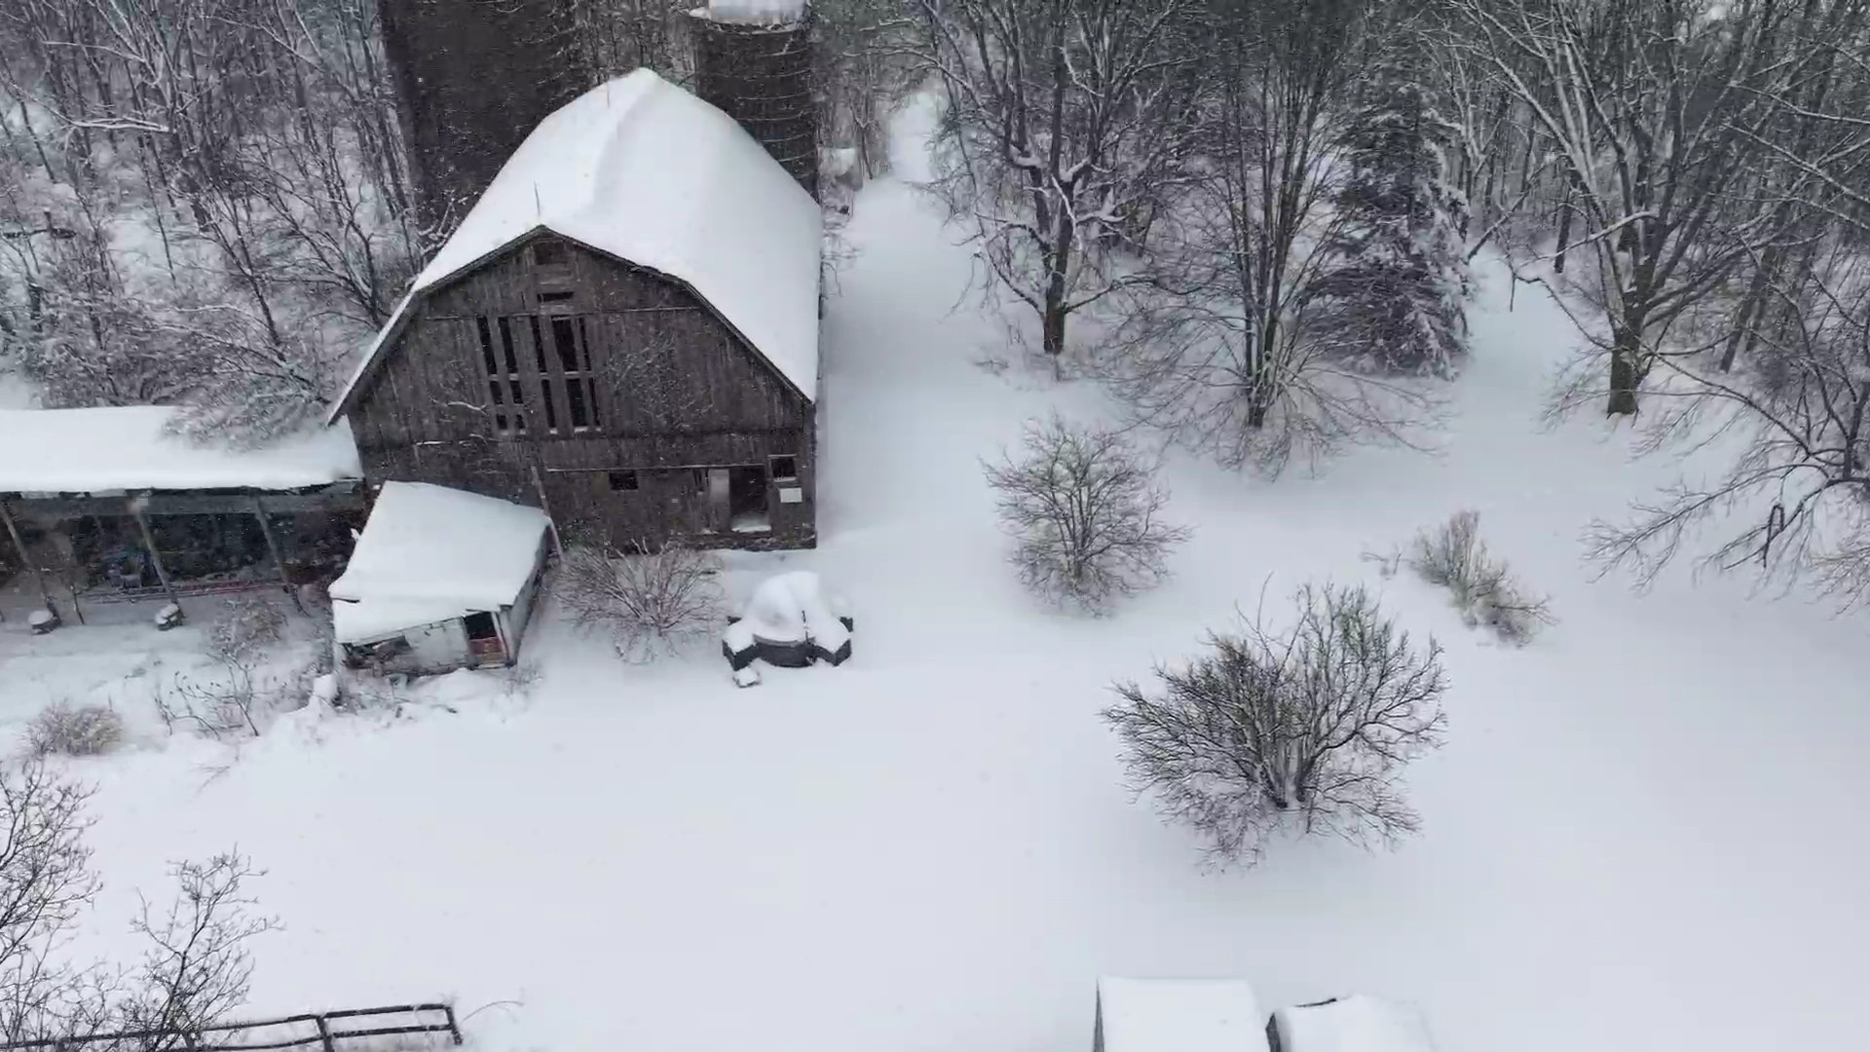
Upstate New York Winter
Notes:
To give you a real sense of what this equipment lives through—this isn't a climate-controlled server room in a data center. This is the operating environment.
We're talking sub-zero winter temperatures, rapid frost and dew formation, and sudden squalls. When something goes wrong out here at 2:00 AM, I don't just need to know about it—I need to know immediately, accurately, and with zero room for false positives before thousands of dollars of glass and electronics freeze or get soaked.

Slide 8
Building the Brain
Transforming Nagios XI into an Autonomous Physical Safety Engine
Notes:
We've seen the hardware, the site constraints, and what an Upstate New York winter looks like. Now let's look at how we solve it.
This next section is about 'Building the Brain'—how we take Nagios XI out of its traditional server-room comfort zone and transform it into an autonomous cyber-physical safety engine.

Slide 9
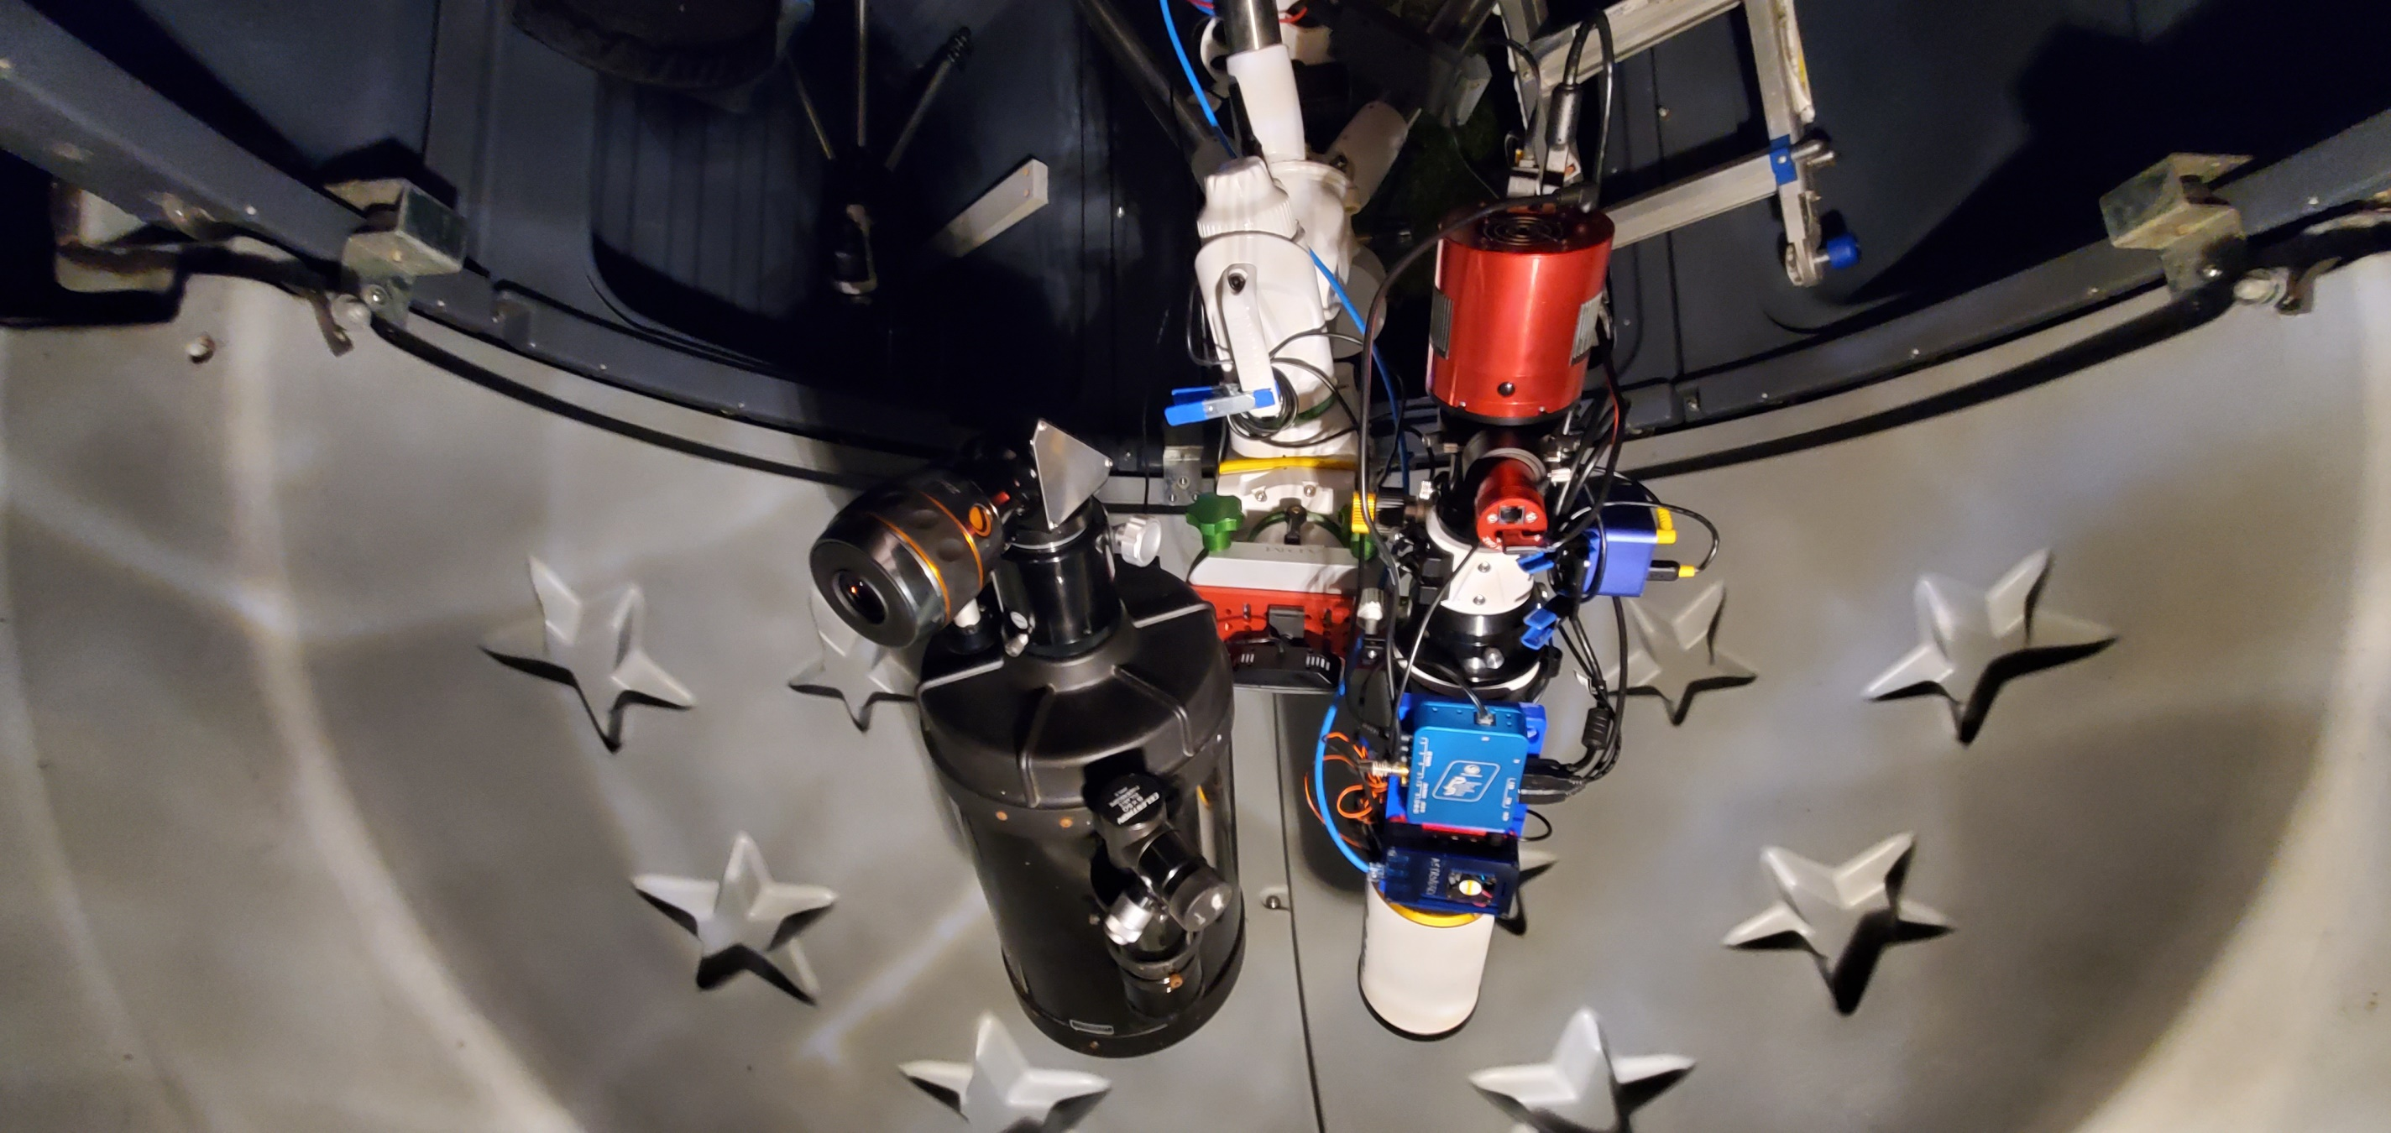
Inside the AstropotaPOD
Thermostat
rPi
Smart Plug
Powerbox
Mini PC
Router
Focuser
Wifi Bridge
Cameras
Camera
Much More
Mount

Slide 10
High-Level
System
Architecture
NINA, Pegasus Power, Sky Quality, Weather JSON/MQTT
nagios_mod_gearman, NCPA, Dynamic Timeperiods, MQTT, InfluxDB
Nagios BPI
Home Assistant, Alexa Voice, Smart Plugs, Push Notifications
Dashboards and Grafana
Turning environmental sensor data into automated hardware protection.
TELEMETRY & SENSORS
CENTRAL MONITORING ENGINE
STATE & DECISION LOGIC
REAL-WORLD ALERTS & ACTION
VISUALIZATION AND HISTORY
Notes:
Here is the complete system architecture.
Telemetry flows from telescope software, weather sensors, and power controllers straight into Nagios XI. From there, Nagios XI splits its job into two parallel streams:
First, performance metrics flow into InfluxDB and Grafana. This gives me historical visualizations—I can track temperature drops, dew point curves, and power consumption over time.
Second, Nagios BPI evaluates real-time health logic. When BPI flags a true critical state, it fires event handlers into Home Assistant and Alexa to trigger physical room alarms and voice warnings.
The result is a closed loop: real-time hardware protection when an issue occurs, and long-term observability through Grafana dashboards.

Slide 11
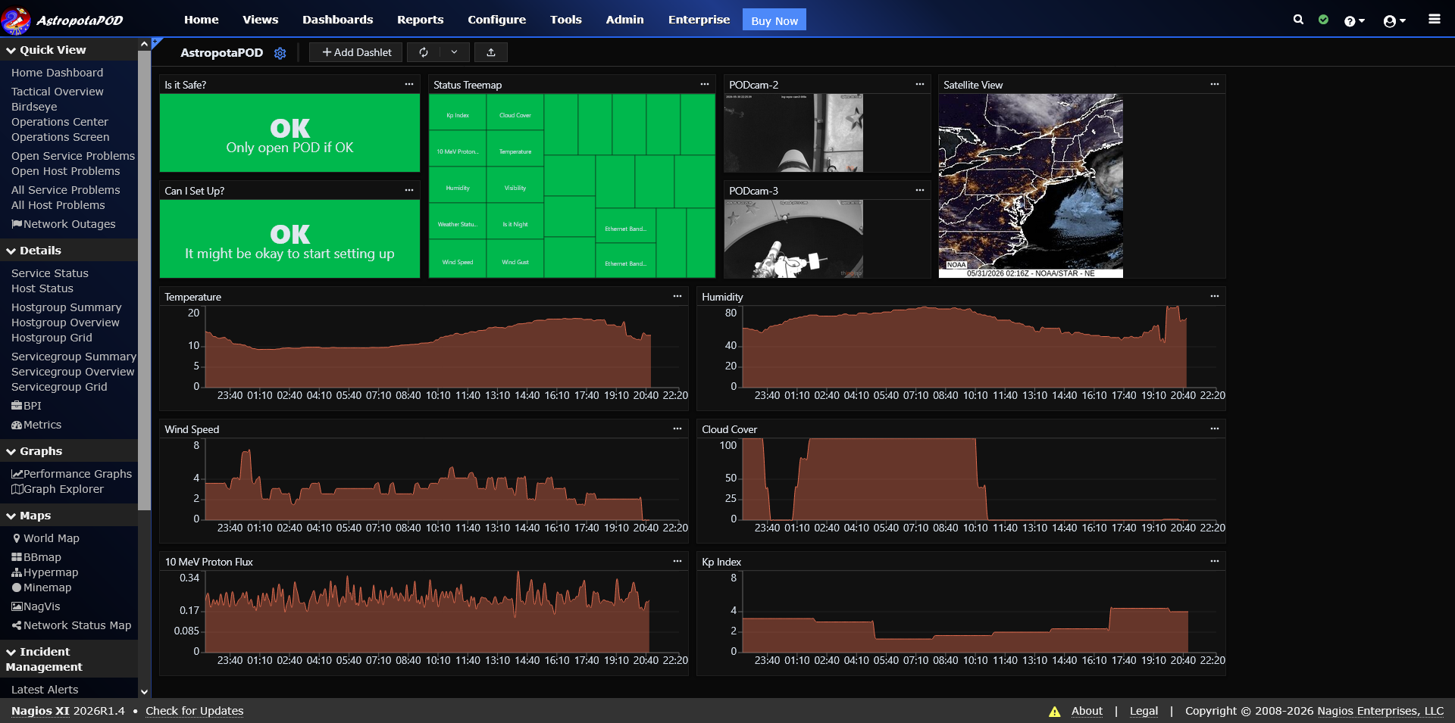

Slide 12
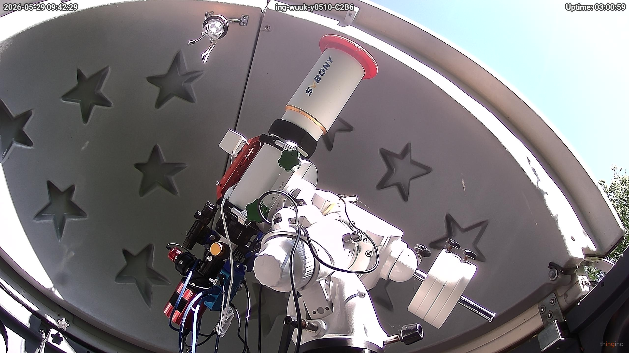
Slewing to the Sun

Slide 13
Data Harvesting:
Sensors, Protocols, & APIs
Pulling hardware metrics from disparate data sources
into Nagios XI using native plugins and custom scripts.

Slide 14
External
Data
Sources
(The Environment)
Ingests severe weather warnings, ambient pressure, precipitation probabilities, cloud cover and more via REST APIs.
Monitors K-index (geomagnetic storms), solar flare activity, and general space weather.
Parses local weather device metrics and Pegasus power box dew-point calculations over MQTT and JSON streams.
Building a comprehensive observatory environmental intelligence pipeline
NATIONAL WEATHER SERVICE (NWS) & OPENWEATHERMAP
SPACE WEATHER PREDICTION CENTER (NOAA / SWPC)
LOCAL MICROCLIMATE & HARDWARE
Notes:
"Once you look under the hood of the ingestion layer, you realize the observatory isn't just listening to local sensors—it's evaluating the total atmospheric and spatial environment.
We pull macro weather data from the National Weather Service and OpenWeatherMap APIs for regional cloud cover and approaching rain fronts. We even query NOAA's Space Weather Prediction Center—monitoring the geomagnetic K-index to track solar storms and aurora activity that impact imaging quality or GPS tracking.
At the ground level, local microclimate sensors and equipment power metrics stream over MQTT and JSON.
Nagios XI sits in the middle as the great normalizer. Using a hybrid mix of active polling scripts and passive MQTT traps, it takes all these completely disparate data sources—from federal satellite APIs down to a local serial port—and translates them into standardized Nagios states with clean performance data."

Slide 15
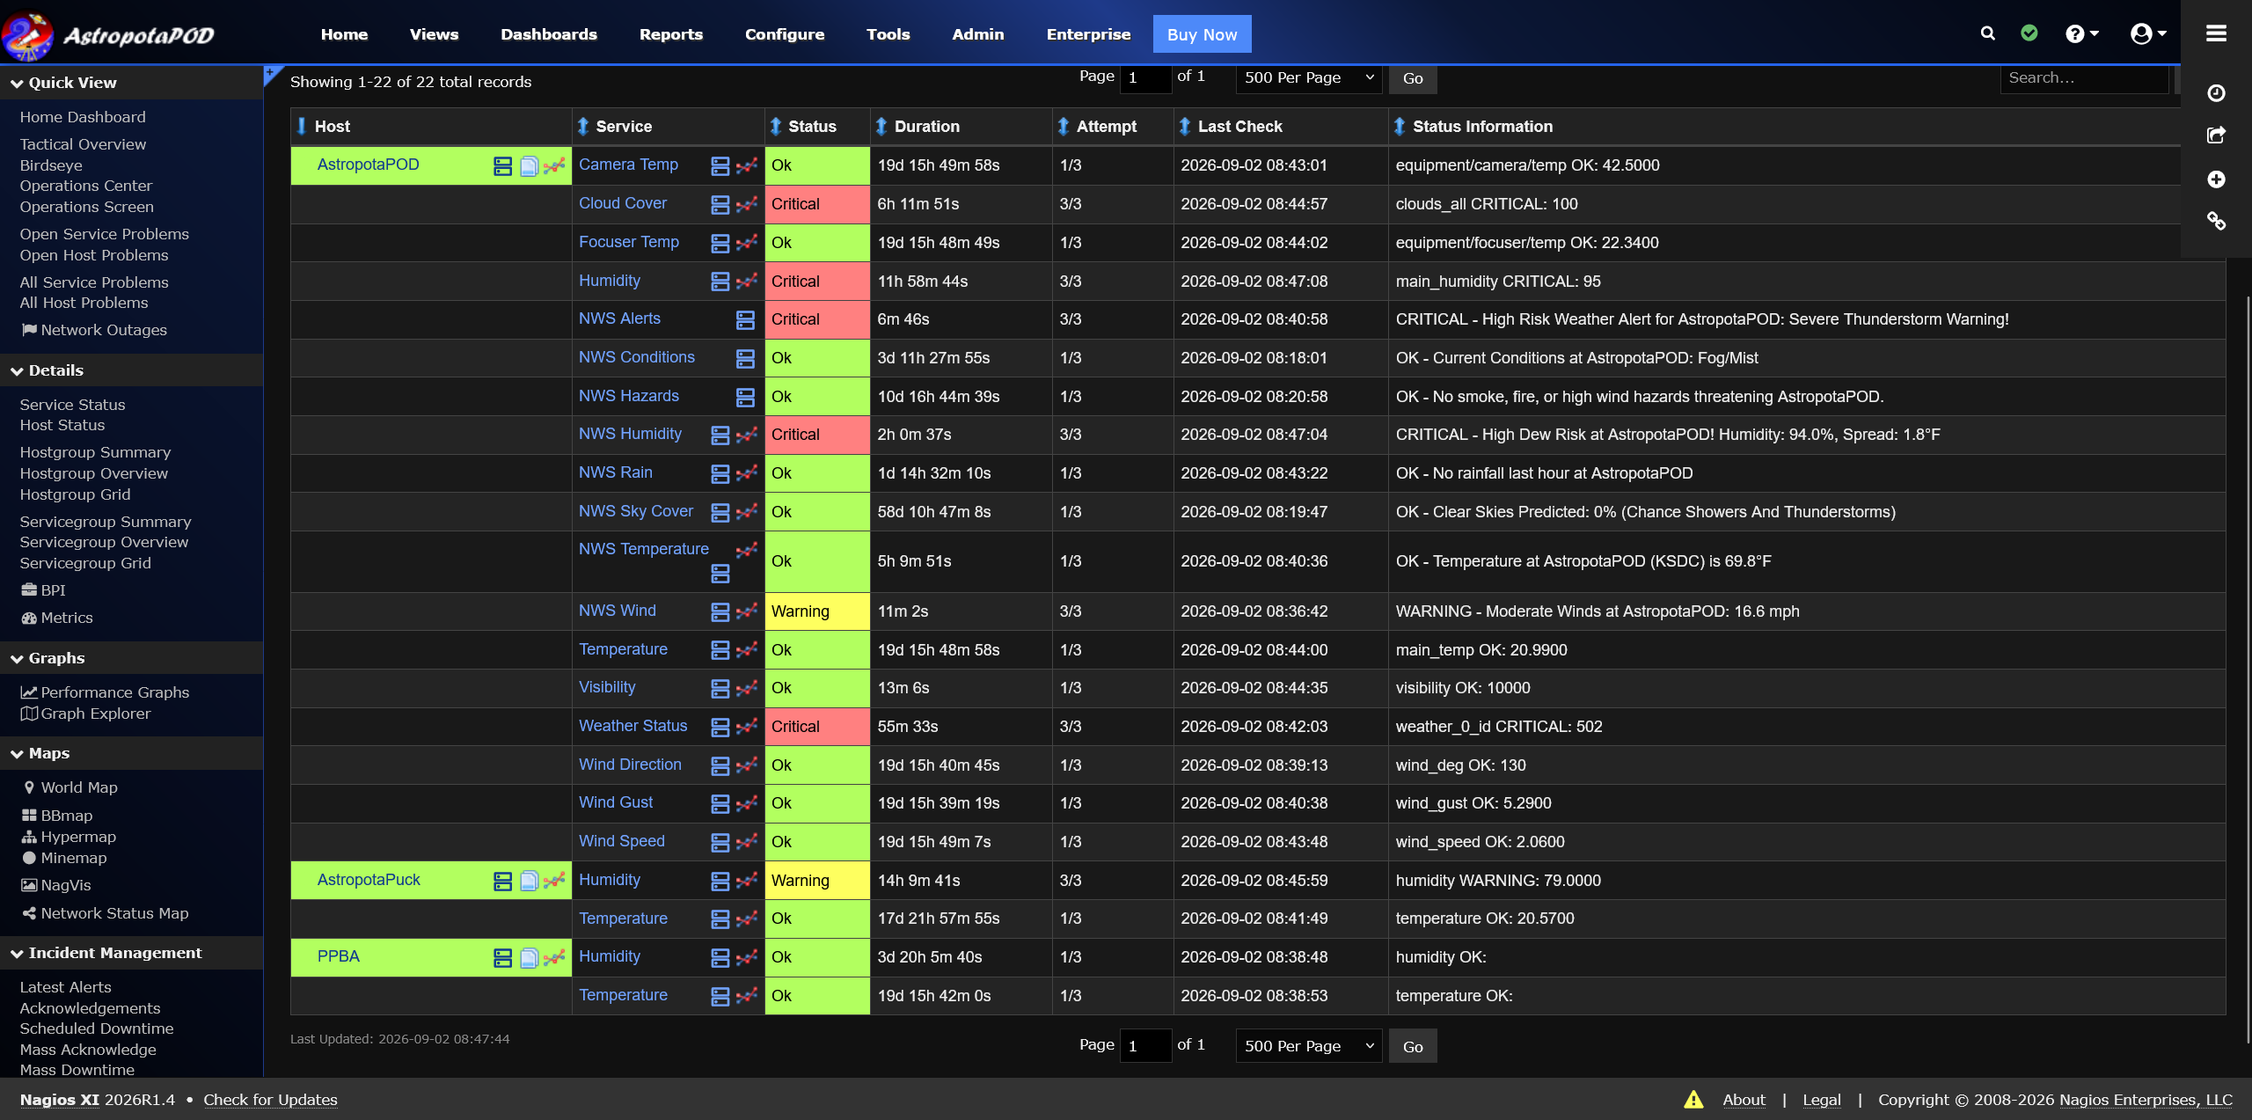

Slide 16
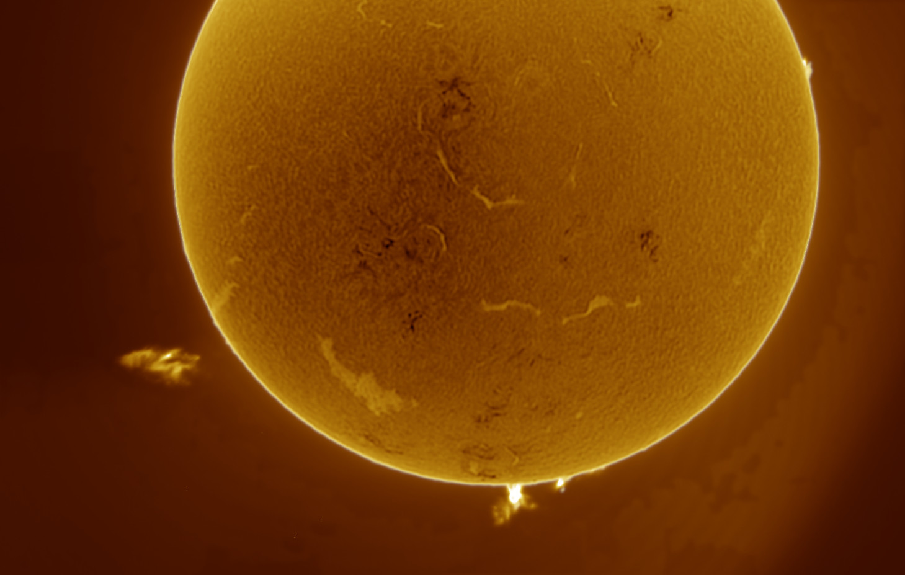
Our Nearest Star

Slide 17
Normalizing
Disparate Streams
Structuring chaotic, multi-source telemetry into a
unified operational monitoring framework.

Slide 18
Nagios as the
Conductor
Translate every external API payload, REST endpoint, and serial string into standard Nagios state logic
(OK, WARNING, CRITICAL).
Rigorous parent/child relationships help ensure devices are properly monitored and notifications correct.
Suppress notifications for things that don’t matter at that moment (no need to alert if it’s noon, for instance).
Adjusts check/notification periods based on astronomical time (e.g., daytime vs. astronomical night, moon phase, imaging windows).
  Update these periods via Nagios XI API
Different hardware, services, APIs, and protocols have different ideas of what their data represents, what is a success or failure, and how to report it. We need to normalize and simplify the results.
STATE STANDARDIZATION
PARENT/CHILD RELATIONSHIPS
SERVICE DEPENDENCY MAPPING
DYNAMIC TIMEPERIODS & SCHEDULES

Slide 19
Nagios as the
Conductor
Combine Weather information into service groups
  Further combine temperature, humidity, and space weather into “sub-service groups”
Telescope target, status, etc goes into its own host and service groups
Combine meta hosts and services into service groups for ease of notification or usage with BPI
Creates a “state machine” of clean, state-aware inputs ready for high-level decision logic.
Different hardware, services, APIs, and protocols have different ideas of what their data represents, what is a success or failure, and how to report it. We need to normalize and simplify the results.
LOGICAL HOST & SERVICE GROUPS
TELESCOPE TARGET INFORMATION
THE BRIDGE TO BPI
Notes:
"So how does Nagios XI take all these completely different data feeds—from space weather satellite APIs down to a local 12-volt power box—and pull them together?
First, it normalizes everything. It doesn't matter if data comes in as a JSON payload, an XML feed from NWS, or an MQTT string—Nagios turns every single metric into a standardized Nagios return code.
Second, it uses host and service groups to organize the observatory into logical domains: the Macro Environment, the Observatory Hardware, and the Imaging Payload.
Third—and this is critical—it applies dynamic timeperiods and dependencies. We don't need high-frequency checks for sky quality at noon when the sun is out, but we need sub-second monitoring during astronomical night when the roof is rolled back.
Once Nagios XI has normalized and grouped all these moving parts, we have a clean, structured foundation. And that sets up the next crucial step: passing these normalized groups into Nagios BPI to make intelligent, multi-condition decisions."

Slide 20
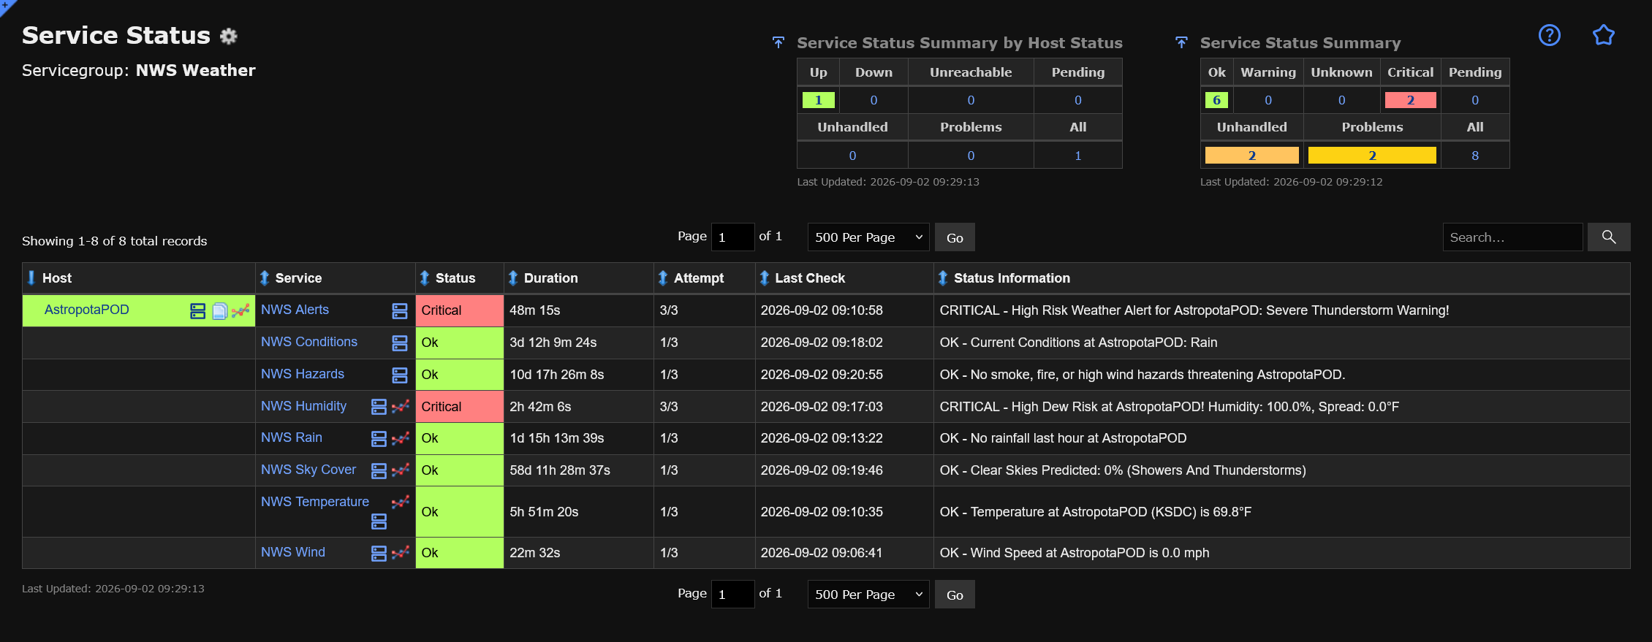

Slide 21
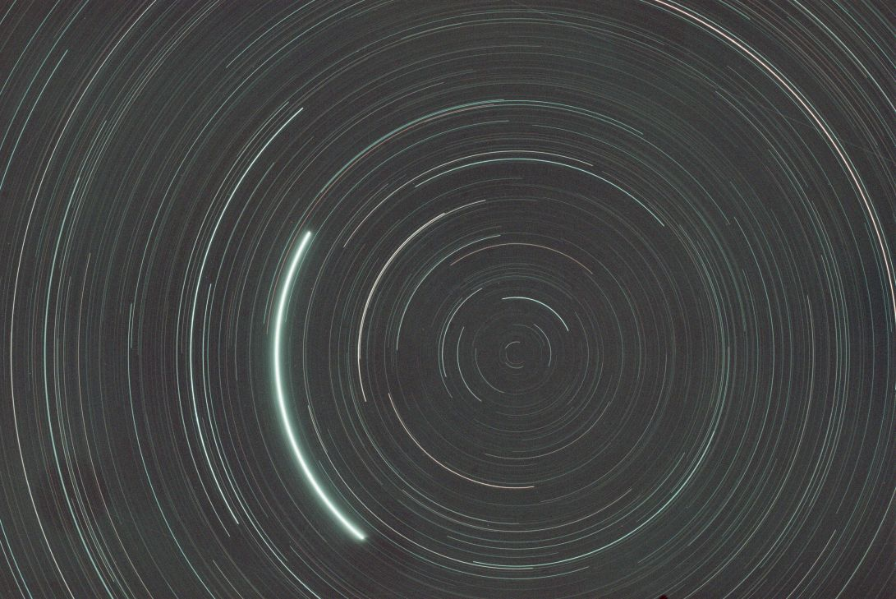
As the World Turns

Slide 22
State-Aware Logic:
Nagios BPI
Evaluating complex multi-condition operational states
to prevent false alarms and force action.

Slide 23
Why
Simple
Checks
Fail
“It’s raining” is meaningless.
  Rain detected when we’re not imaging:
  Do nothing (sleep)
  Rain detected when we are imaging:
  Threat to gear (wake up immediately).
Passing wispy clouds or temporary dew point spikes shouldn't set off alarms at 3:00 AM.
Multiple alerts or flapping for something that isn’t a problem leads to “Boy Who Cried Wolf” scenario.
Simple thresholds can't evaluate context; BPI correlates states across hosts, services, and groups.
Remember our goal: provide meaningful notifications when the AstropotaPOD is in danger of inadequately protecting the astrophotography equipment.
ISOLATED METRICS LACK CONTEXT
THE DANGER OF FLAPPING & FALSE POSITIVE FATIGUE
THE NEED FOR BUSINESS PROCESS INTELLIGENCE
Notes:
"Now we reach the brain of the operation: Nagios BPI, or Business Process Intelligence.
In traditional IT, if a server CPU hits 99%, it's bad regardless. But in a physical observatory, single metrics are completely meaningless without context.
Consider rain: If rain is detected at 2:00 AM, is that a critical alert? If the observatory roof is closed and locked, no—it's just a rainy night, and I should keep sleeping. But if the roof is open and the camera is capturing exposures, rain is a catastrophic failure.

Slide 24
BPI
Decision
Matrix
BPI creates “meta services” like:
  IsItSafe (rain, winds, smoke, etc)
  AreWeImaging (power status, mount unparked, NINA active)
Combine things:
  If we’re not imaging, we don’t care
  If we are, then make sure IsItSafe sends alerts
Assigns mathematical thresholds (e.g., At least 2 of 7 weather checks must be non-OK) to prevent single-sensor failure false alarms.
Thresholds don’t have to be numeric. AreWeImaging is just looking for OK/not OK on certain boolean services
Remember our goal: provide meaningful notifications when the AstropotaPOD is in danger of inadequately protecting the astrophotography equipment.
GROUP AGGREGATION LOGIC
ESSENTIAL EVALUATION RULES
THRESHOLD WEIGHTING
Notes:
Standard Nagios service checks evaluate metrics in isolation. BPI lets us build a meta-service that looks at the entire picture simultaneously. It evaluates Roof State, Environmental Threat, and Imaging Activity as a single mathematical group.
If Roof is OPEN AND Rain is CRITICAL, BPI flips the master state to CRITICAL. If the roof is closed, it suppresses the alert. That contextual logic is what gives us absolute reliability with zero false-alarm wake-up calls."

Slide 25
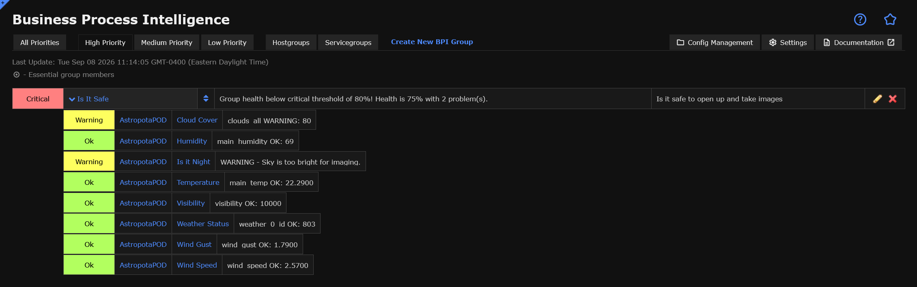

Slide 26
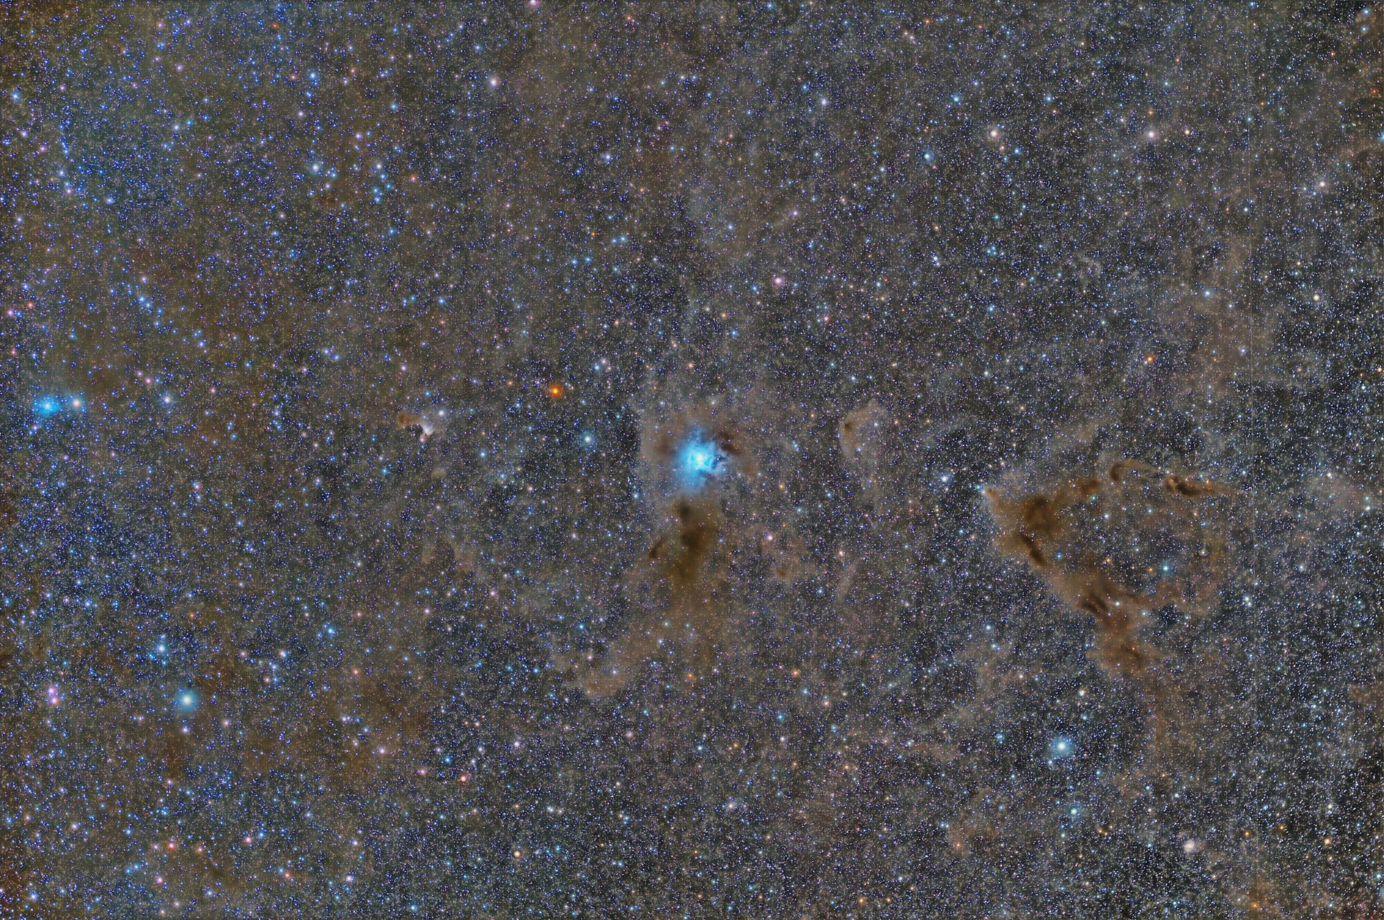
The Iris Nebula

Slide 27
Real-World Alerts
& Escalation
Bridging Nagios Notifications with Smart-Home Automation
Notes:
"Now that Nagios BPI is acting as the state-aware decision engine, we face the final hurdle: what happens when BPI actually flags a CRITICAL state at 3:00 AM?
Sending an email or a quiet phone notification isn't going to cut it when thousands of dollars of glass and electronics are exposed to a sudden downpour.
In this next section, we look at 'Real-World Alerts & Escalation'—how we hook Nagios XI event handlers directly into Home Assistant and smart-home infrastructure to create unavoidable physical alarms."

Slide 28
Notification
Sequence
Nagios BPI detects: we are imaging and it starts to rain or lightning
  We don’t care about clouds; they make for bad images but won’t ruin equipment
We use a contact with a notification command as if it were an event handler to drop payload into MQTT and send push notifications
Home Assistant monitors MQTT, processes state payload & determines priority alert path
  If not home, Alexa won’t help, use critical push
Alert vectors:
  Alexa Voice: “ALERT: Close the POD!”
  Lighting: Bedroom lights flash high-contrast red and white (Alexa routine)
  Mobile Push: Critical bypass notification (overrides Do Not Disturb)
How do we know when it’s time to close up the AstropotaPOD?
BPI CRITICAL TRIGGER
NAGIOS META-EVENT HANDLER
HOME ASSISTANT
MULTI-CHANNEL ACTION
Notes:
"Now that Nagios BPI is acting as our state-aware decision engine, what happens when it actually detects a CRITICAL threat at 3:00 AM?
Sending a quiet email or a phone buzz isn't going to cut it when thousands of dollars of equipment are sitting under an open sky in a sudden downpour.
Here is the exact escalation workflow:
When BPI flips to CRITICAL, Nagios XI immediately fires a custom event handler script. That event handler hits a secure webhook on Home Assistant.
Home Assistant acts as our physical router: it bypasses iPhone 'Do Not Disturb' settings with high-priority critical push alerts, flashes the bedroom smart lights bright red, and commands Alexa to repeatedly broadcast text-to-speech voice warnings through the house until the roof sensor confirms the observatory is closed and safe."

Slide 29
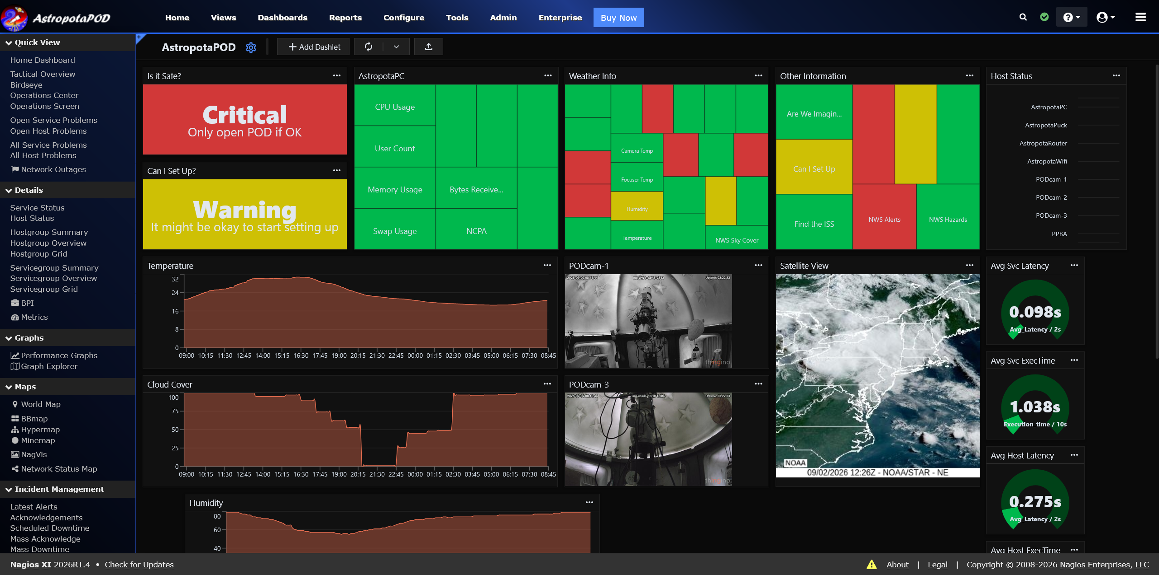

Slide 30
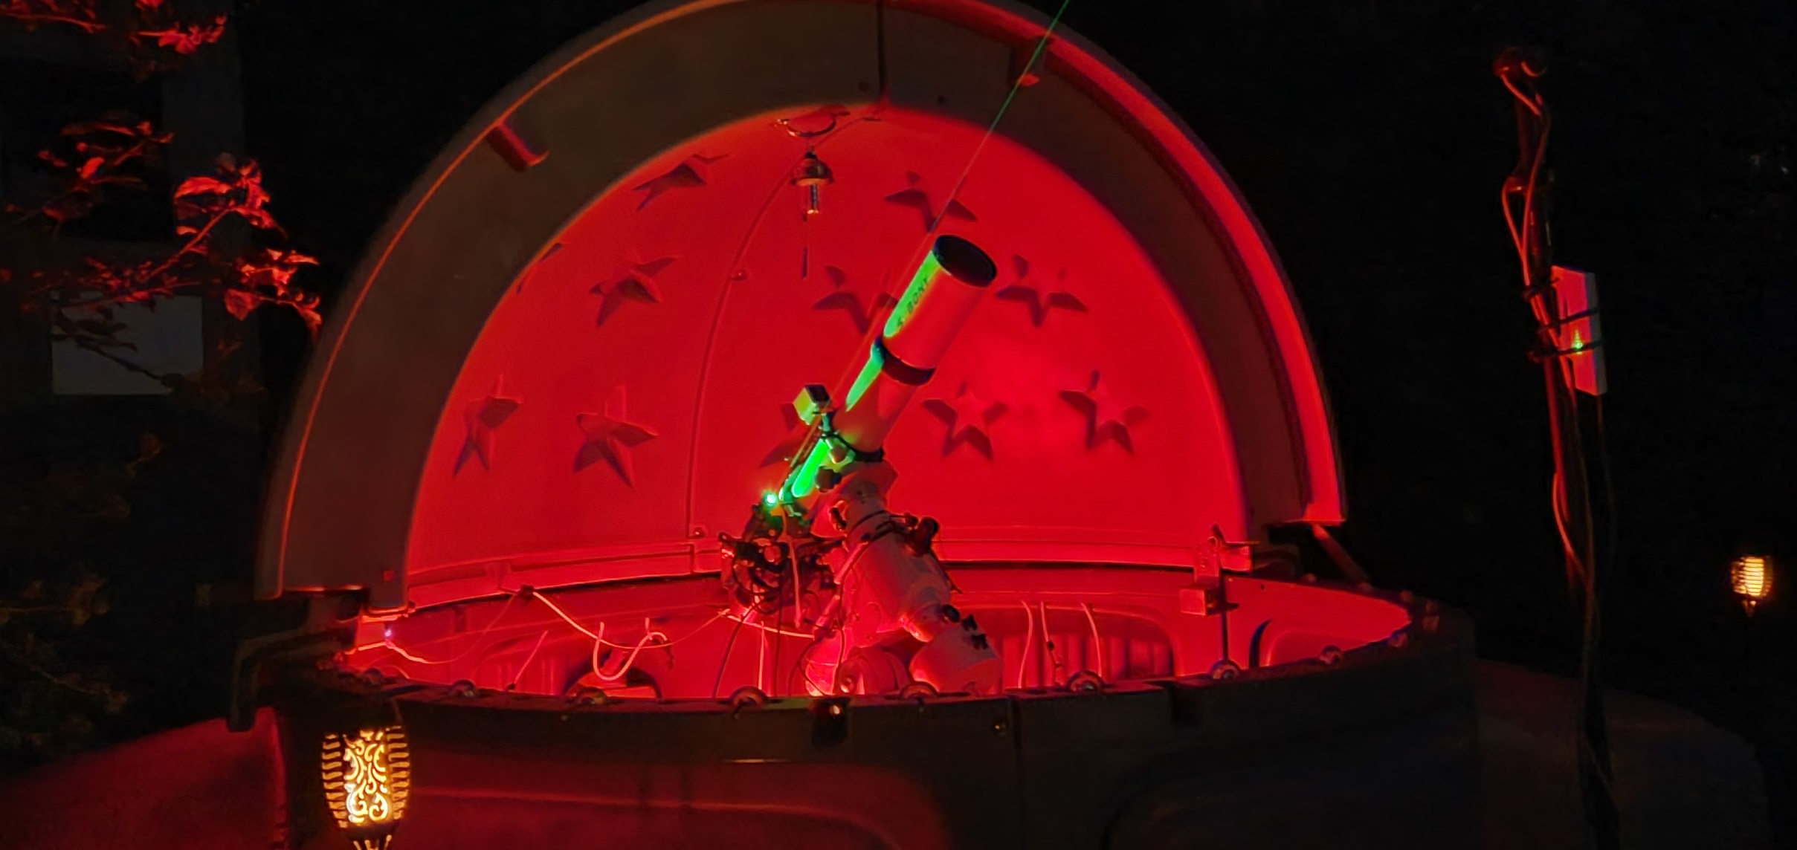
Space Lasers

Slide 31
Live Demo?
Let’s see if this works
Notes:
"PowerPoint slides and diagrams are great, but let's see how this actually behaves live.
I'm going to run a real-time scenario through the system.
First, we have our baseline: the rain sensor is tripped, but because the roof status is registered as CLOSED, Nagios BPI correctly evaluates the state as OK and keeps the house quiet.
Now, I'm going to manually flip the observatory roof state to OPEN while the rain trigger is active.
Watch Nagios XI: within seconds, BPI evaluates the combined condition, flips the master service to CRITICAL, fires the event handler payload to Home Assistant, and... [trigger live Alexa / light response in the room or video feed]."

Slide 32
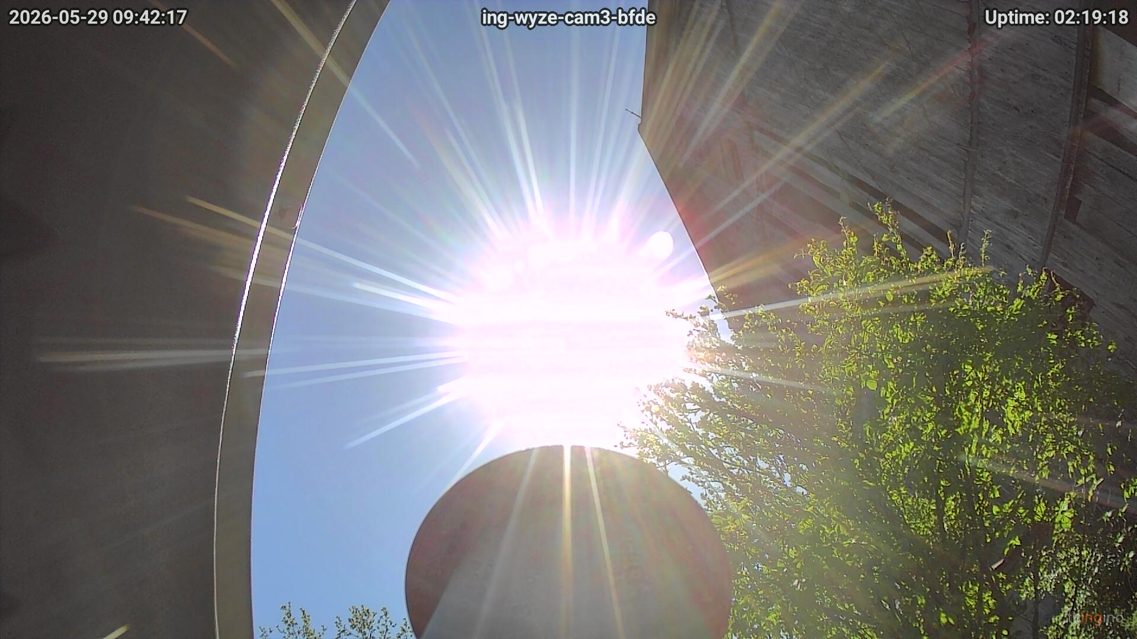

Slide 33
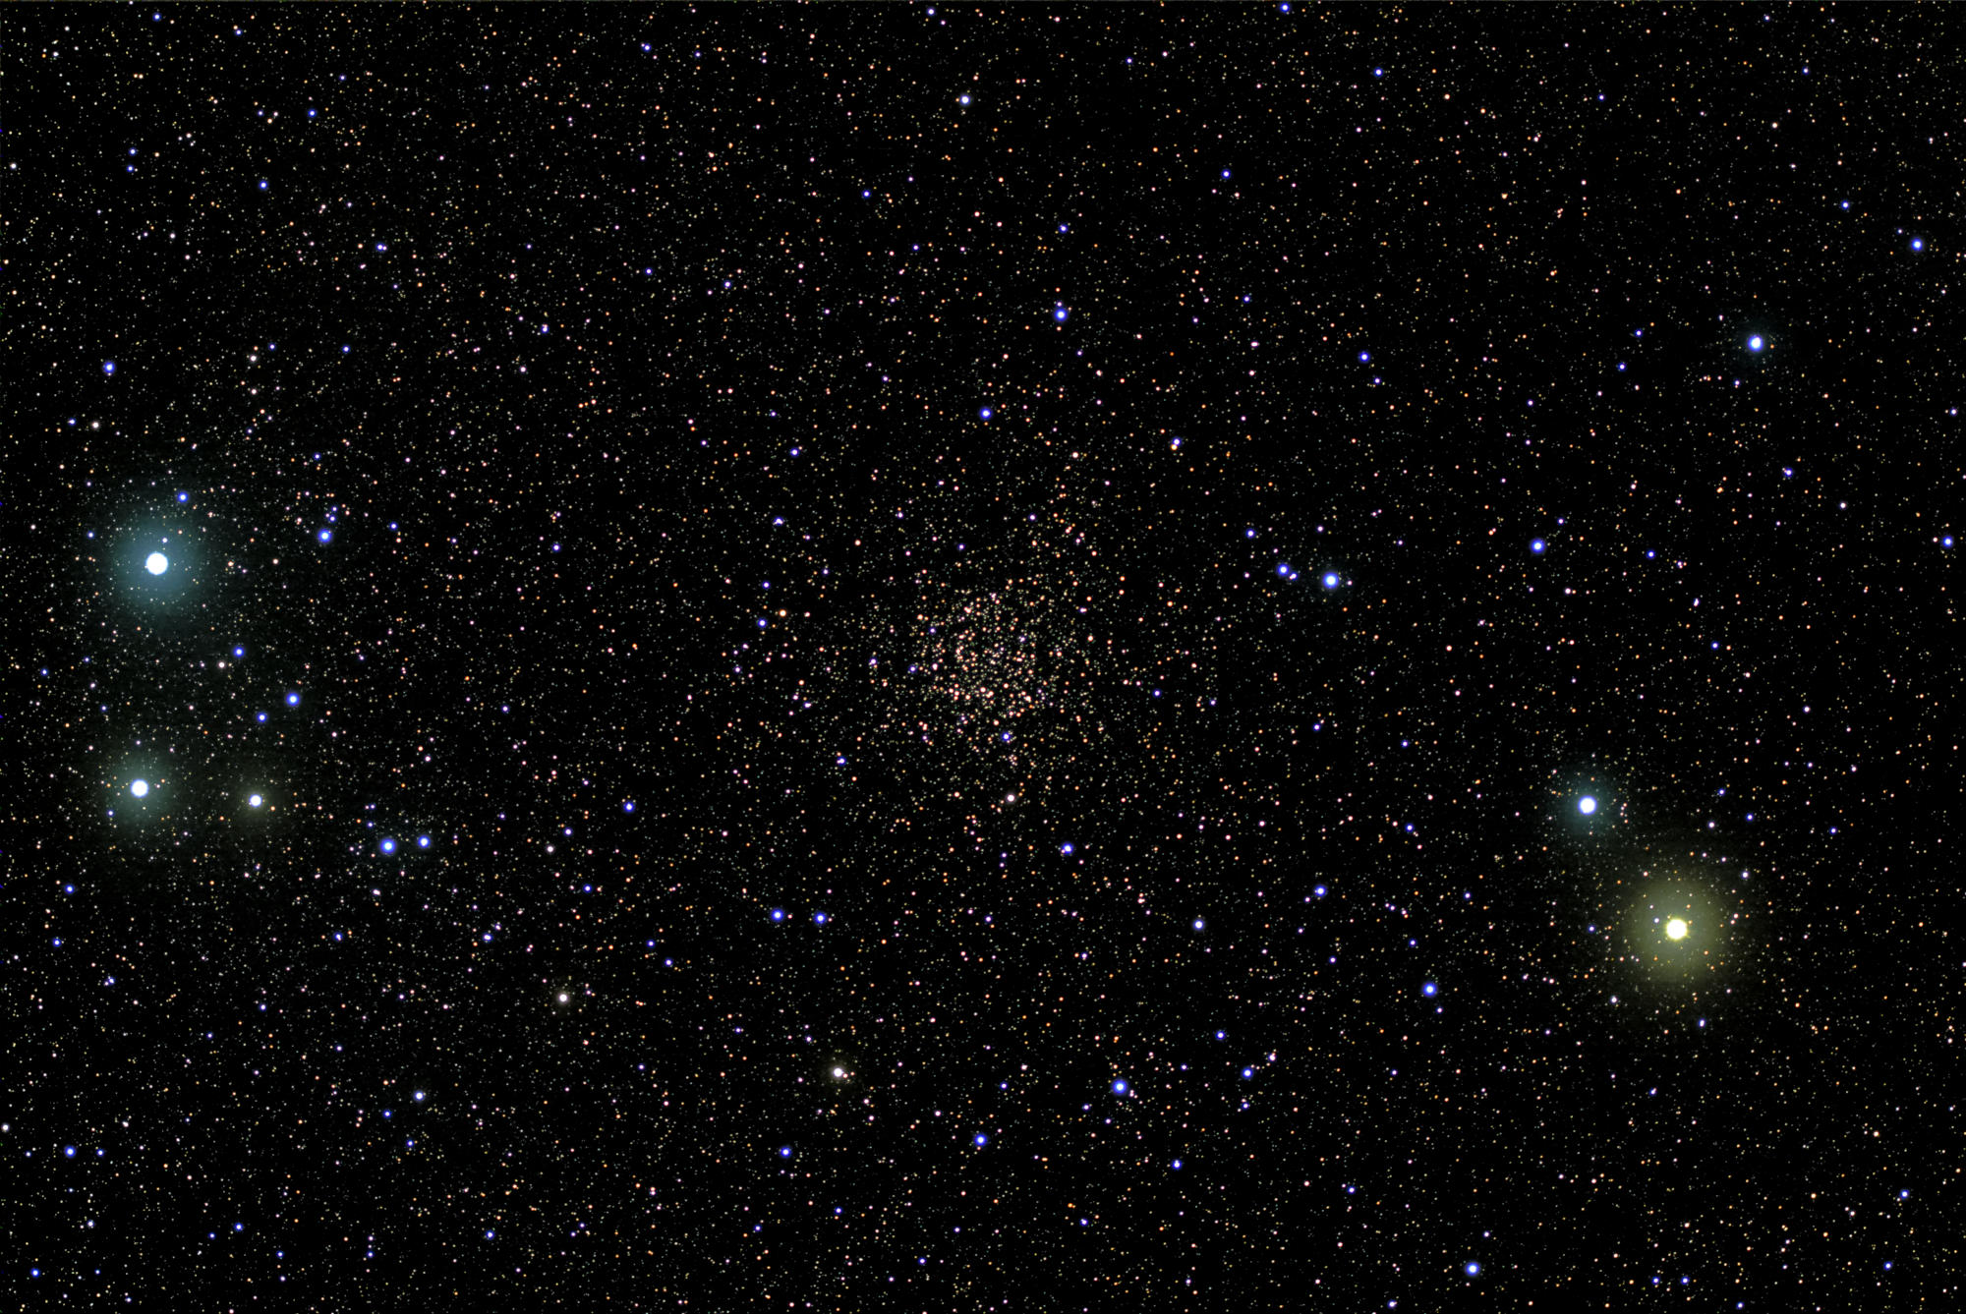
Caroline’s Rose Cluster

Slide 34
Considerations
& Concerns
What happens if it all goes ass-over-teakettle?

Slide 35
System
Constraints &
Failure
Modes
Remote APIs (NWS, SWPC) and push notifications rely on Internet connectivity
WireGuard/Tailscale VPN allows XI/POD communication
  VPN failure = no monitoring
Local ISP goes out if there’s a lightning strike nearby
  No ISP = no monitoring
Grid brownouts or surges during storms can cause reboots of USB controllers or local Pi / mini-PC nodes.
  No power = no monitoring
Outdoor rain sensors oxidize; optical cloud sensors accumulate frost/dust; temperature/dew-point calibration shifts over time in Upstate NY winters.
  No sensors = degraded monitoring
It’s all fun and games until it rains on your telescope. What are some things that we have to be aware of?
REMOTE EXECUTION and APIs
VPN DEPENDENCY
ISP OUTAGES
POWER GRID INSTABILITY
SENSOR DRIFT
Notes:
"Every complex remote system has edge cases, and building an automated observatory in Upstate New York taught us some hard operational lessons.
First is network dependency. While we query cloud APIs like NWS and SWPC, our critical safety logic cannot depend on an internet connection. If the home ISP drops during a blizzard, Nagios and Home Assistant talk locally over the LAN to trigger physical alarms.
Second is physical sensor reliability. Rain sensors oxidize, optical lenses freeze over, and hardware drifts. To combat this, we implement staleness watchdogs in Nagios—if a sensor stops reporting data for more than two minutes, Nagios flags a sensor fault state instead of assuming everything is fine.
Finally, power loss. A UPS backs up our core controller and Nagios node, giving us enough battery runway to execute an automated, safe roof-park sequence before power drains completely."

Slide 36
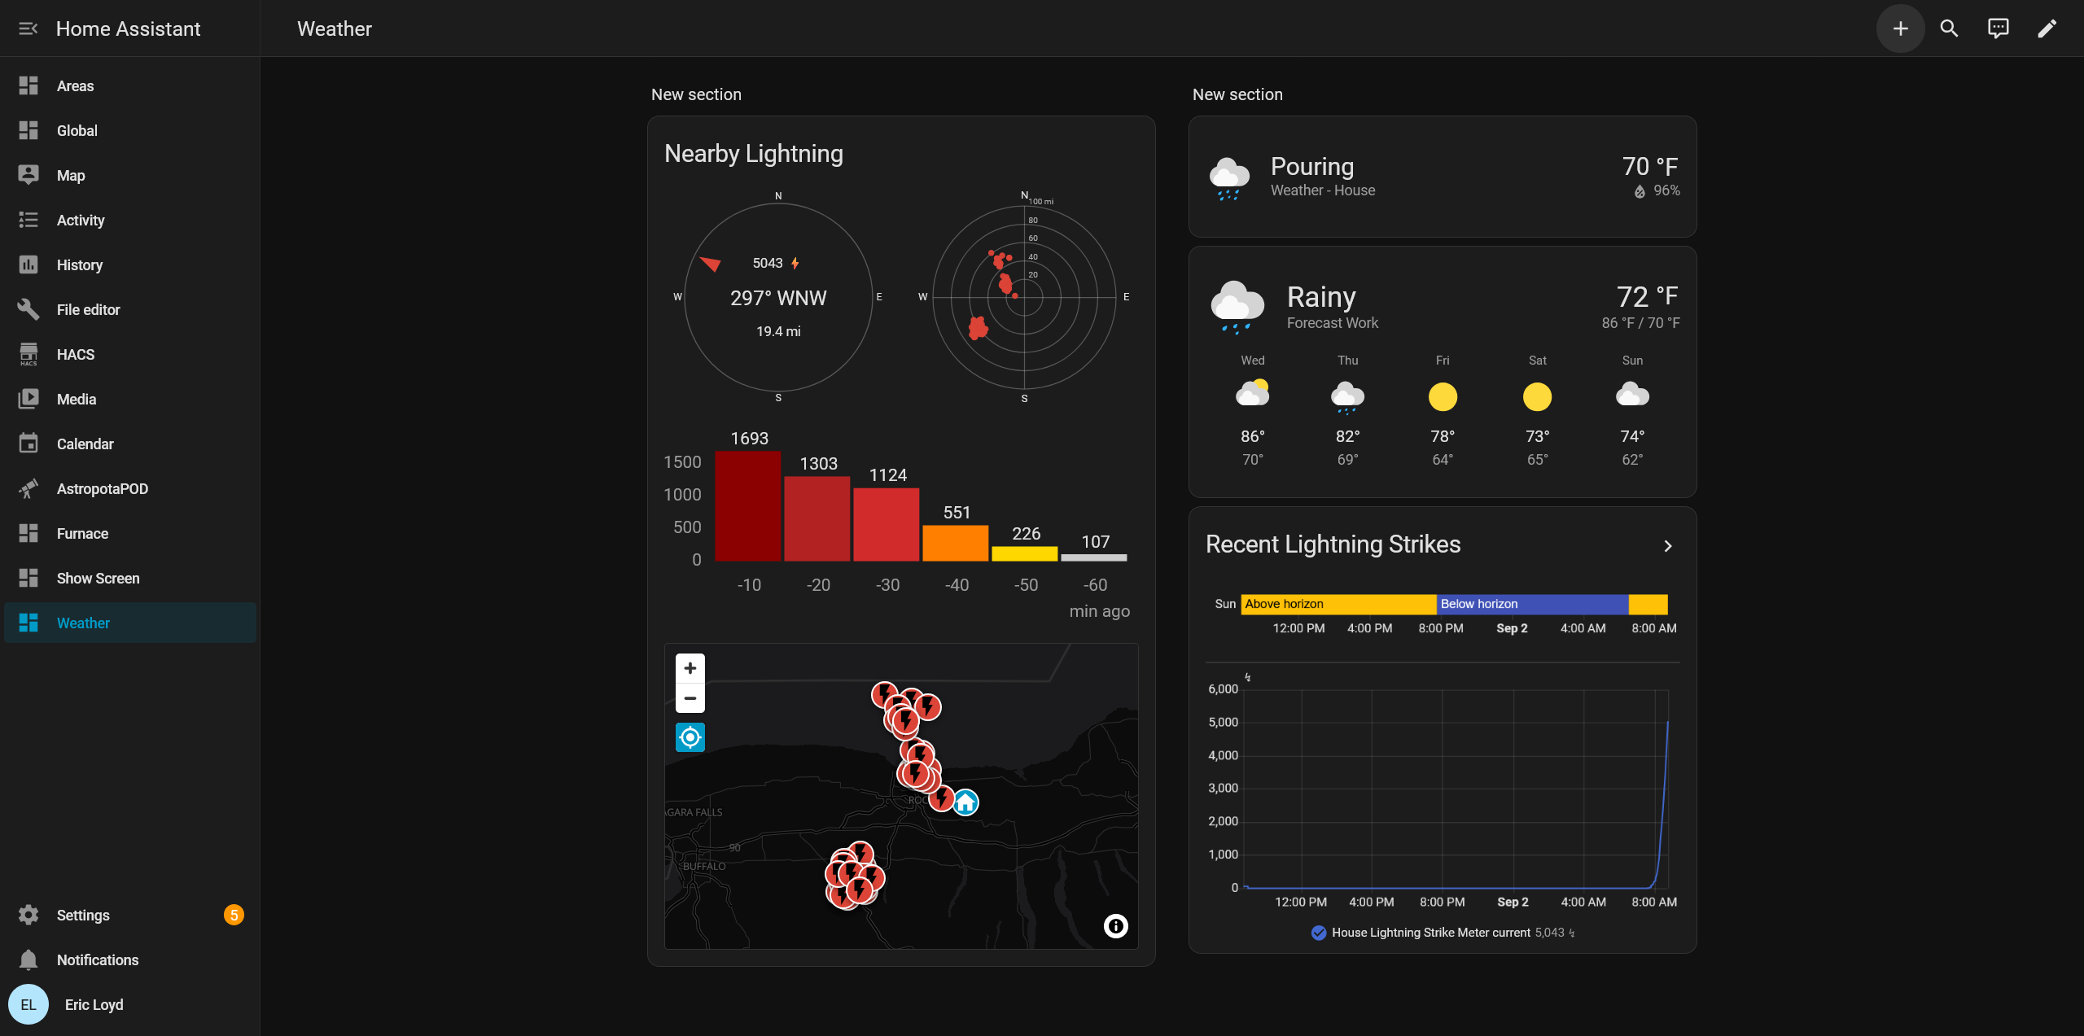

Slide 37
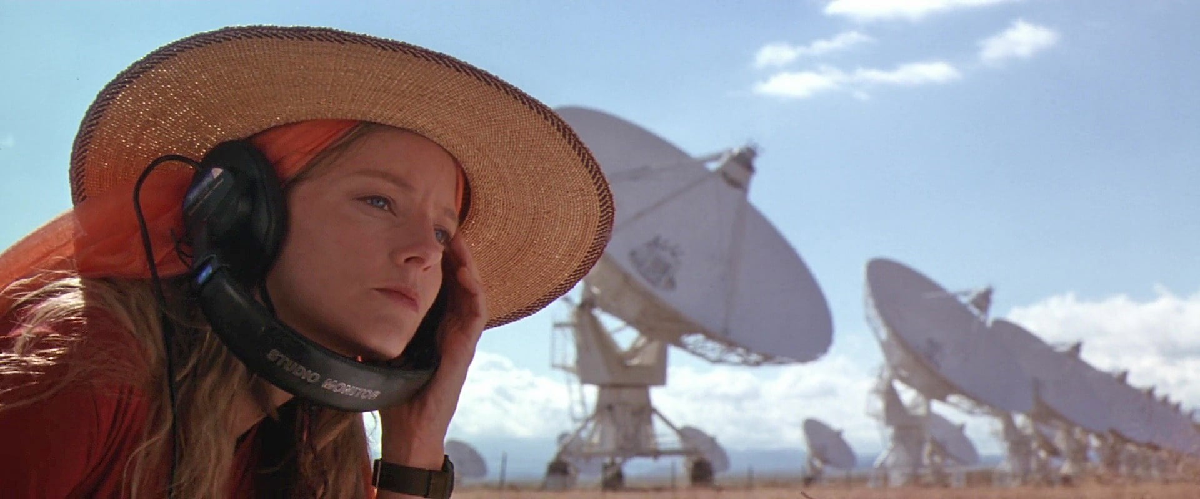
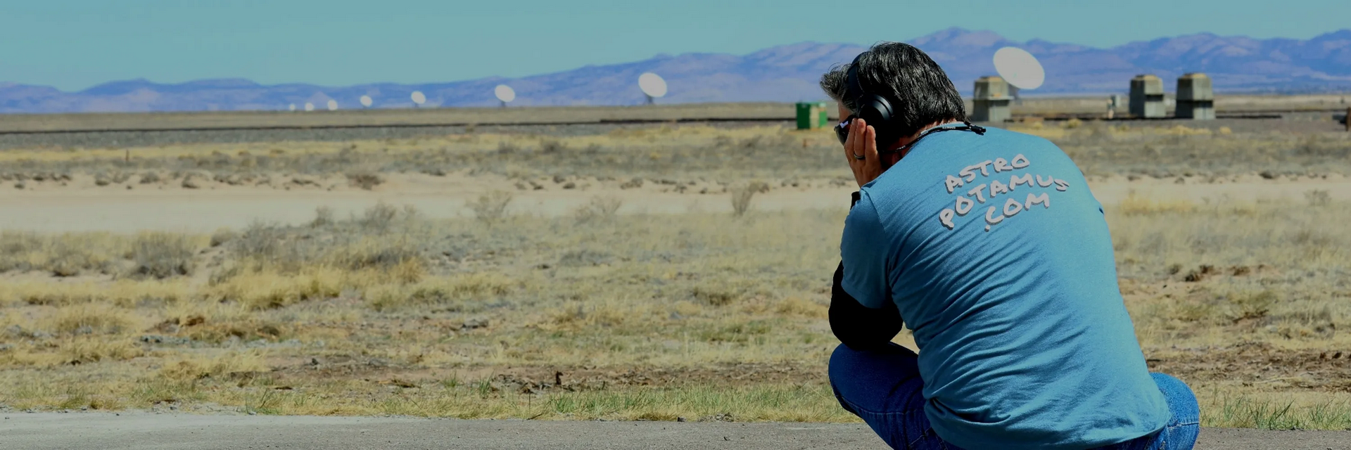

Slide 38
Is it Really “Remote” if it’s in your Back Yard?
Treating home automation with enterprise-grade
IT infrastructure discipline.

Slide 39
Operational
Lessons
Learned
Even if it’s 50 yards away in the backyard, pulling on boots at 3:00 AM in a sub-zero Upstate NY snowstorm to close the POD represents real potential for catastrophic failure.
High-value optics and sensitive electronics demand the same monitoring rigor, state logic, and redundancy as a corporate datacenter.
Context-aware state logic such as parent/child relationships, dependences, and BPI prevents alert fatigue, saving both equipment and your sleep.
Standard IT monitoring tools adapt remarkably well to real-world hardware, IoT streams, and physical safety automation. This is all OSS.*
Keeping telemetry collection, decision logic, and physical alert execution decoupled makes the system modular, resilient, and easy to maintain.
Autonomous safety automation turns a high-stress hobby into a reliable, hands-off imaging operation.
“Remote” is not a distance, it’s a mindset.
TREAT PHYSICAL ASSETS LIKE CRITICAL INFRASTRUCTURE
ALERT QUALITY OVER ALERT QUANTITY
NAGIOS XI BEYOND THE DATACENTER
DECOUPLED ARCHITECTURE WORKS
PEACE OF MIND
*Nagios XI is not OSS but you could do all this with Core.
Notes:
"To wrap things up: why go through all this effort just to run an observatory in your own backyard?
Because 'remote' isn't about miles—it's about operational mindset. Trudging through knee-deep snow at three in the morning because a rain sensor gave a false alarm is a system failure. Treating your backyard setup with the same engineering discipline as a remote enterprise datacenter changes everything.
Nagios XI proved to be the ultimate orchestrator here. By pairing its state monitoring and BPI logic with local home automation, we built a system that protects high-value gear, eliminates false wake-up calls, and lets me sleep soundly while the telescope shoots all night.
Thank you—and I'd love to take any questions!"

Slide 40
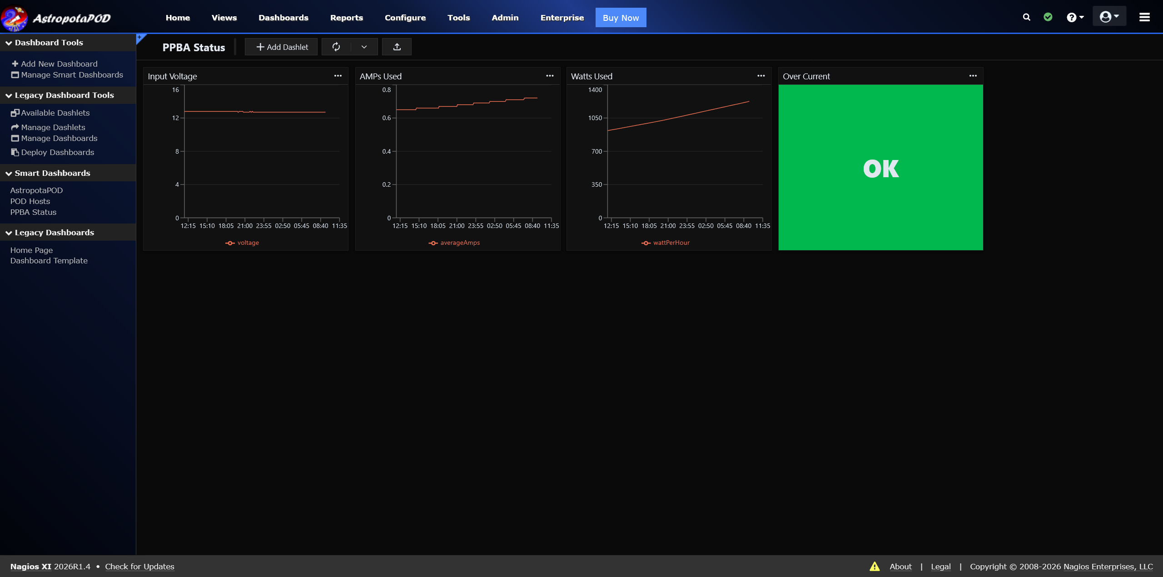
Notes:
"To wrap things up: why go through all this effort just to run an observatory in your own backyard?
Because 'remote' isn't about miles—it's about operational mindset. Trudging through knee-deep snow at three in the morning because a rain sensor gave a false alarm is a system failure. Treating your backyard setup with the same engineering discipline as a remote enterprise datacenter changes everything.
Nagios XI proved to be the ultimate orchestrator here. By pairing its state monitoring and BPI logic with local home automation, we built a system that protects high-value gear, eliminates false wake-up calls, and lets me sleep soundly while the telescope shoots all night.
Thank you—and I'd love to take any questions!"

Slide 41
Grafana
Grafana for the Time Series Data Visualization Win!

Slide 42
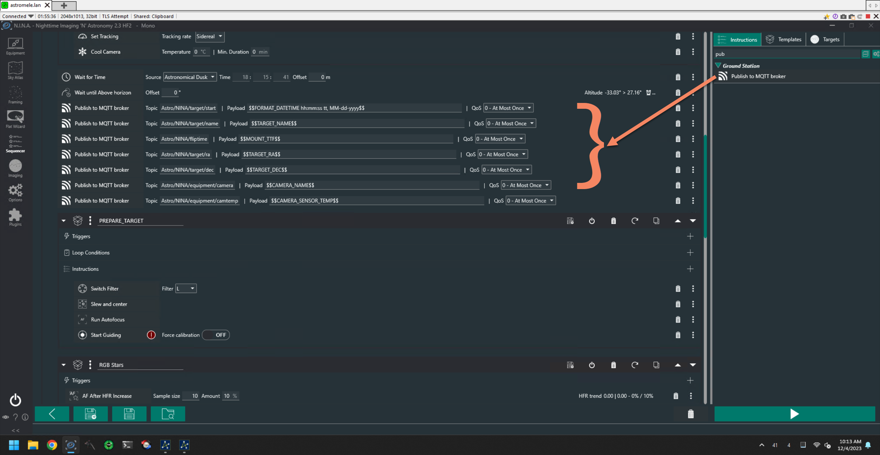

Slide 43
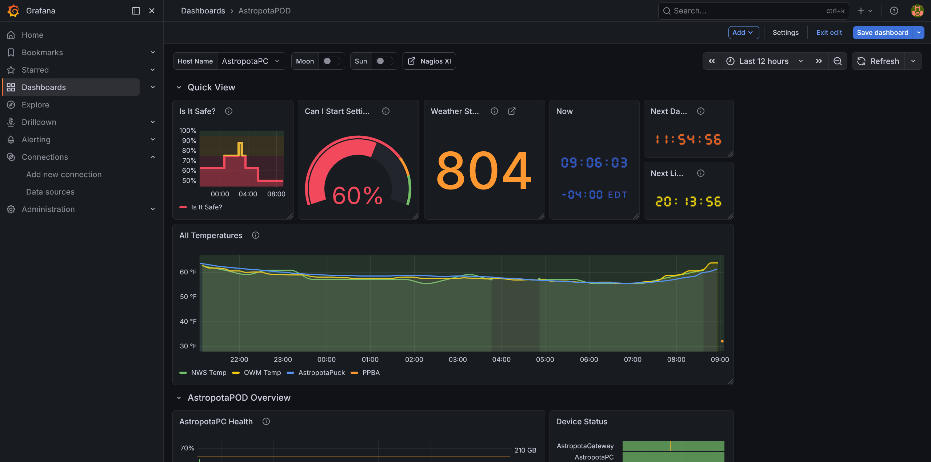

Slide 44
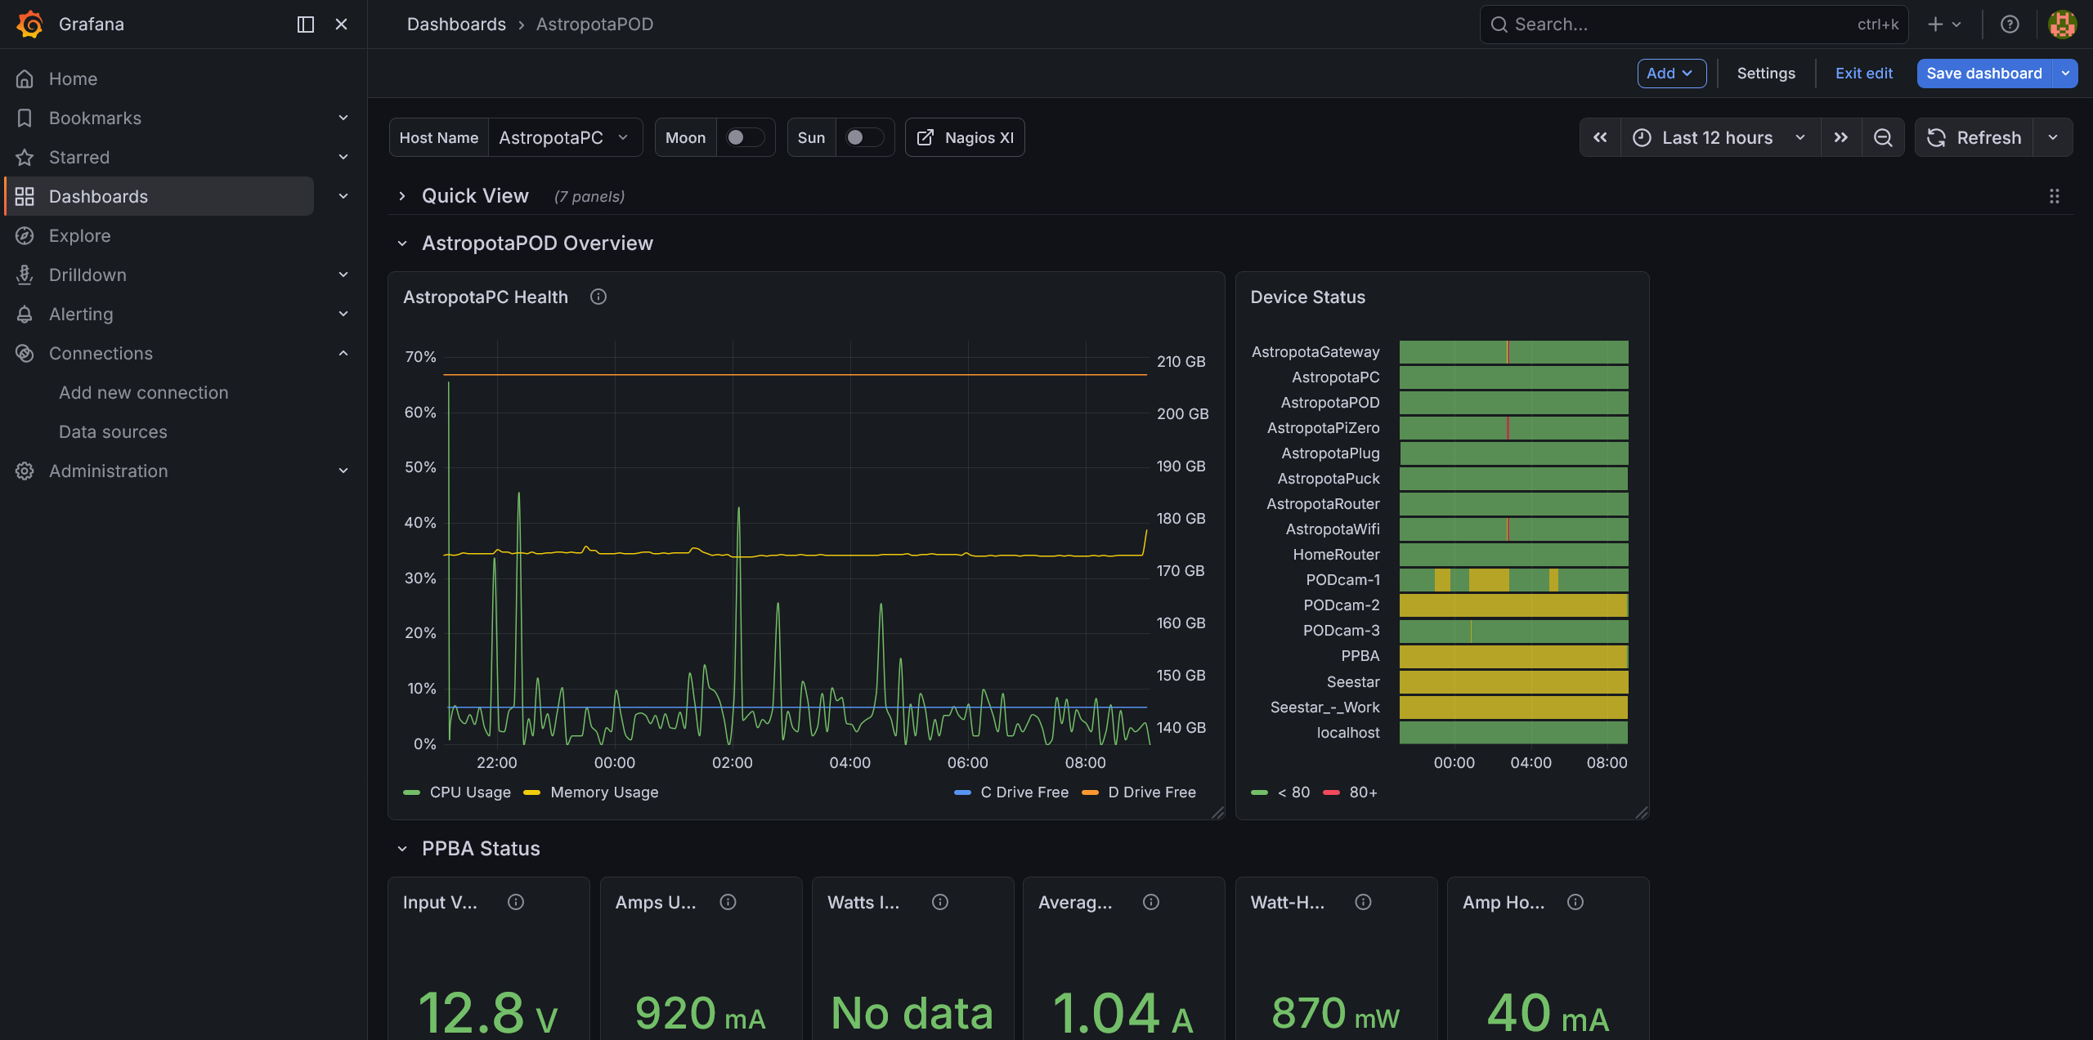

Slide 45
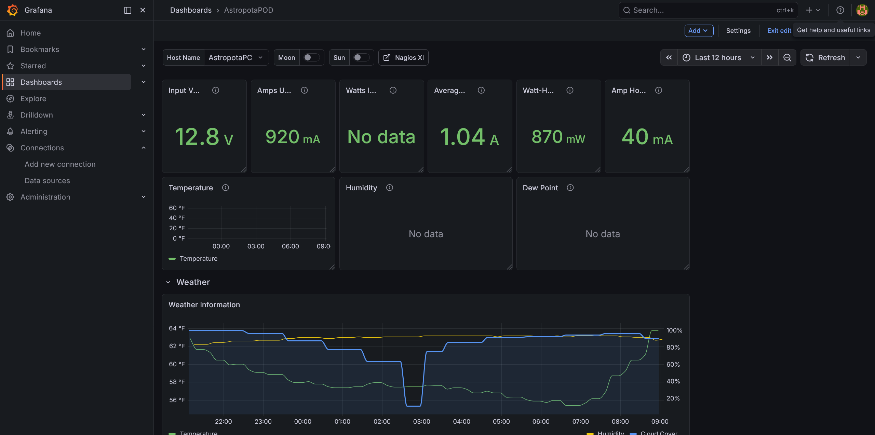

Slide 46
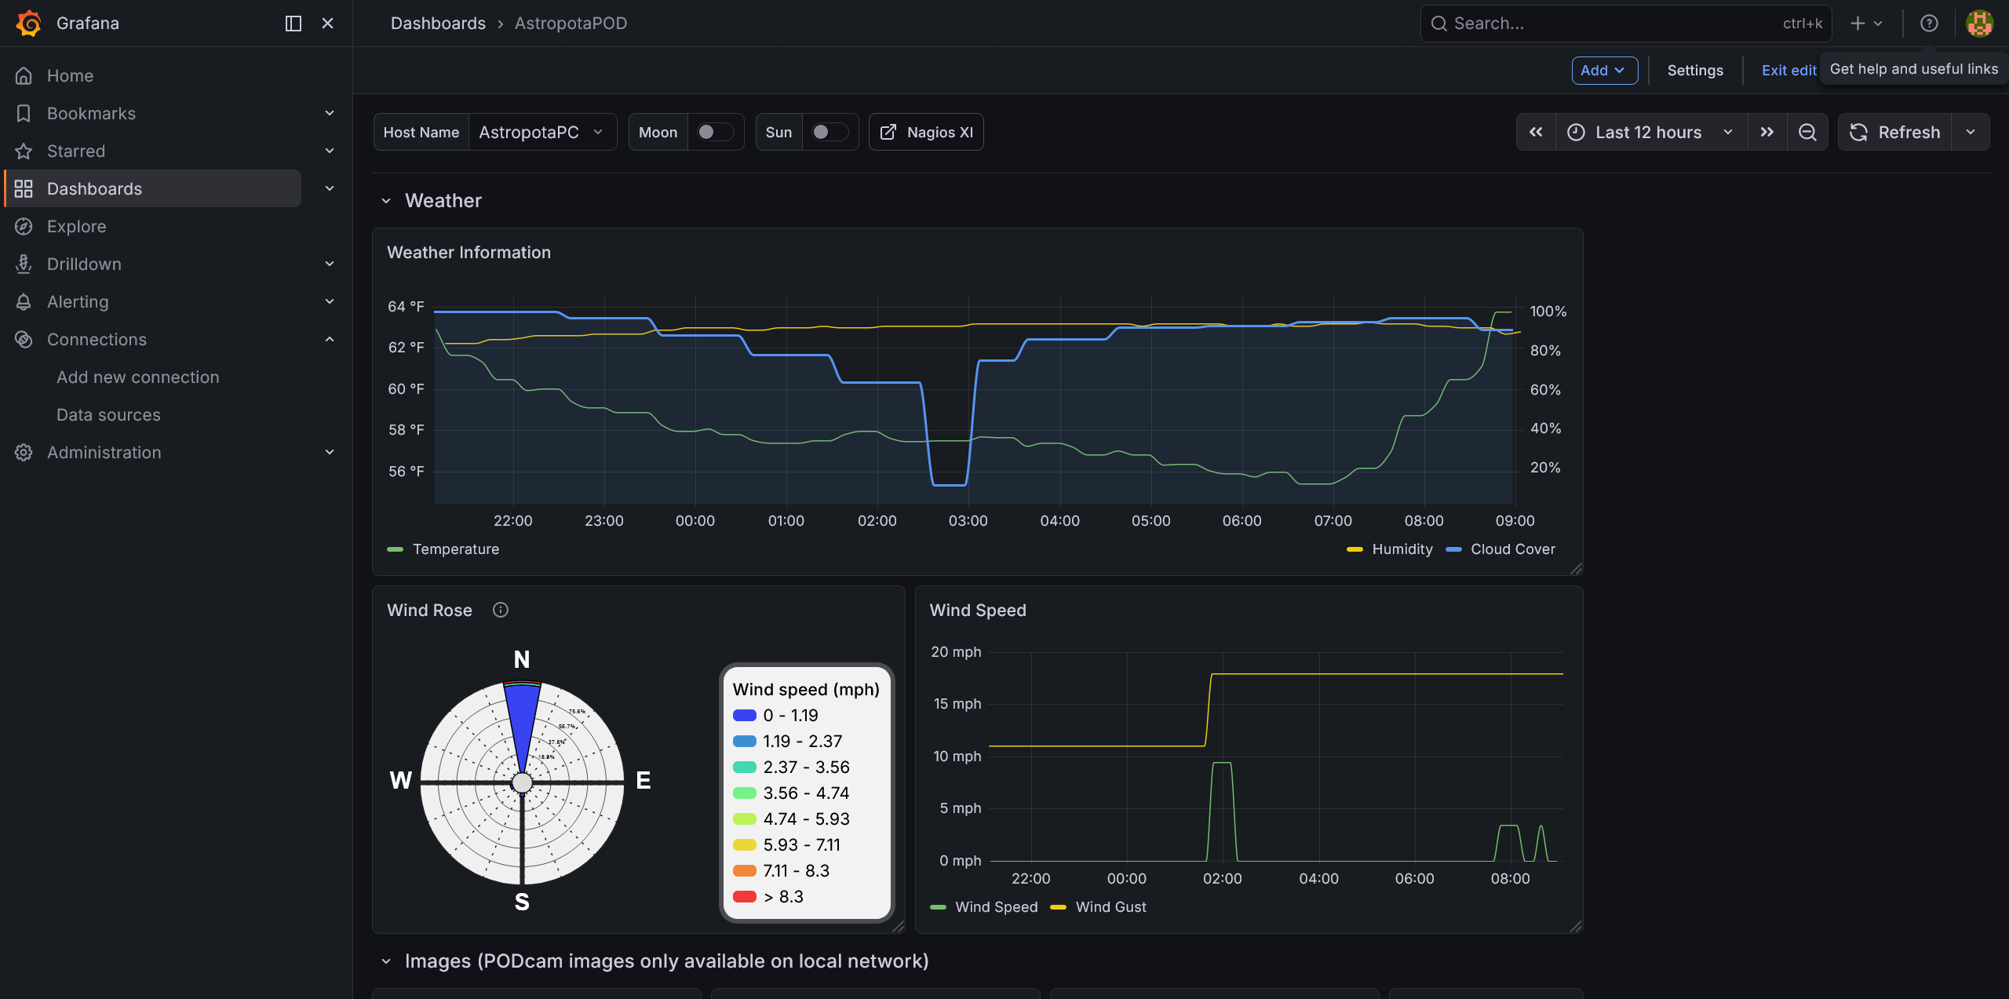

Slide 47
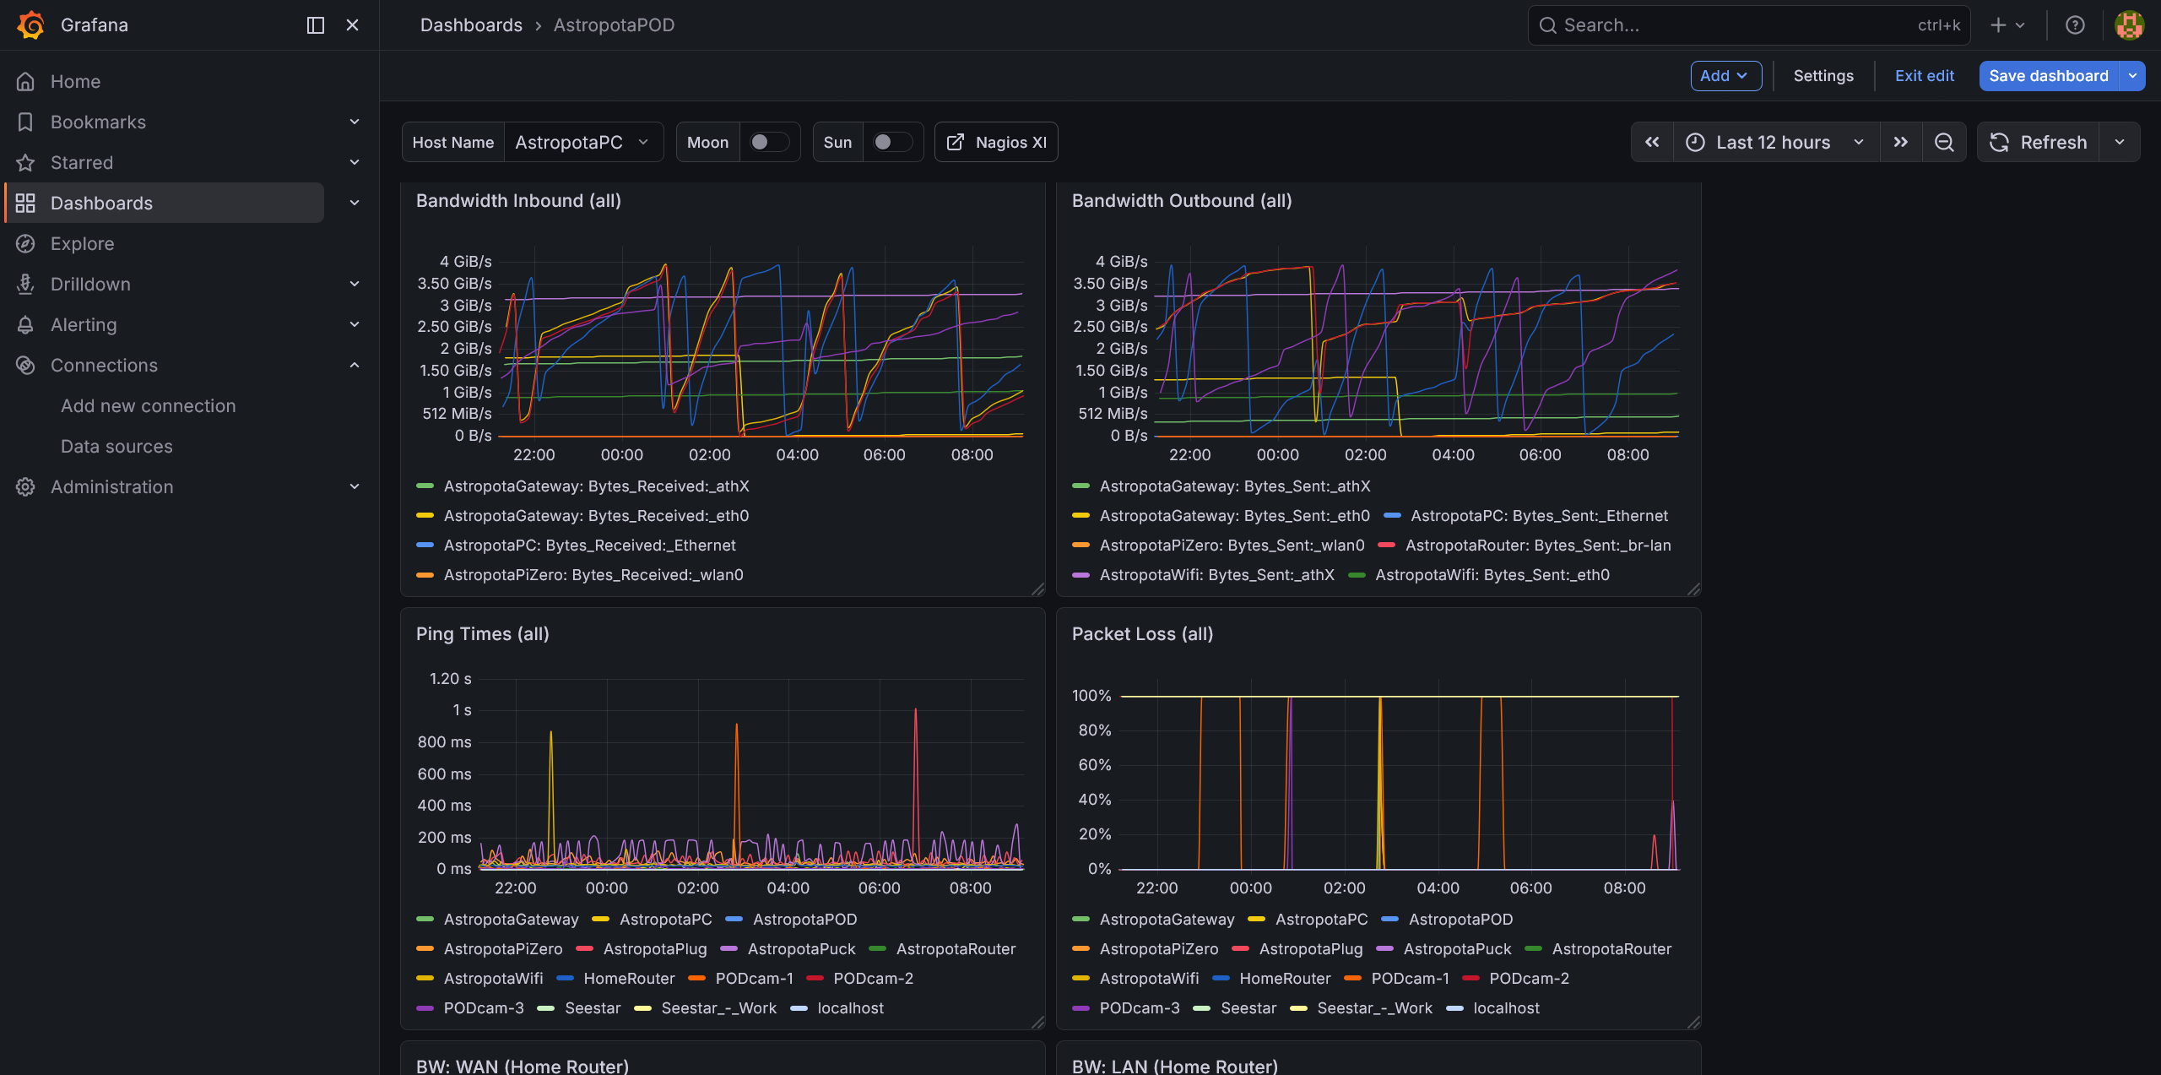

Slide 48
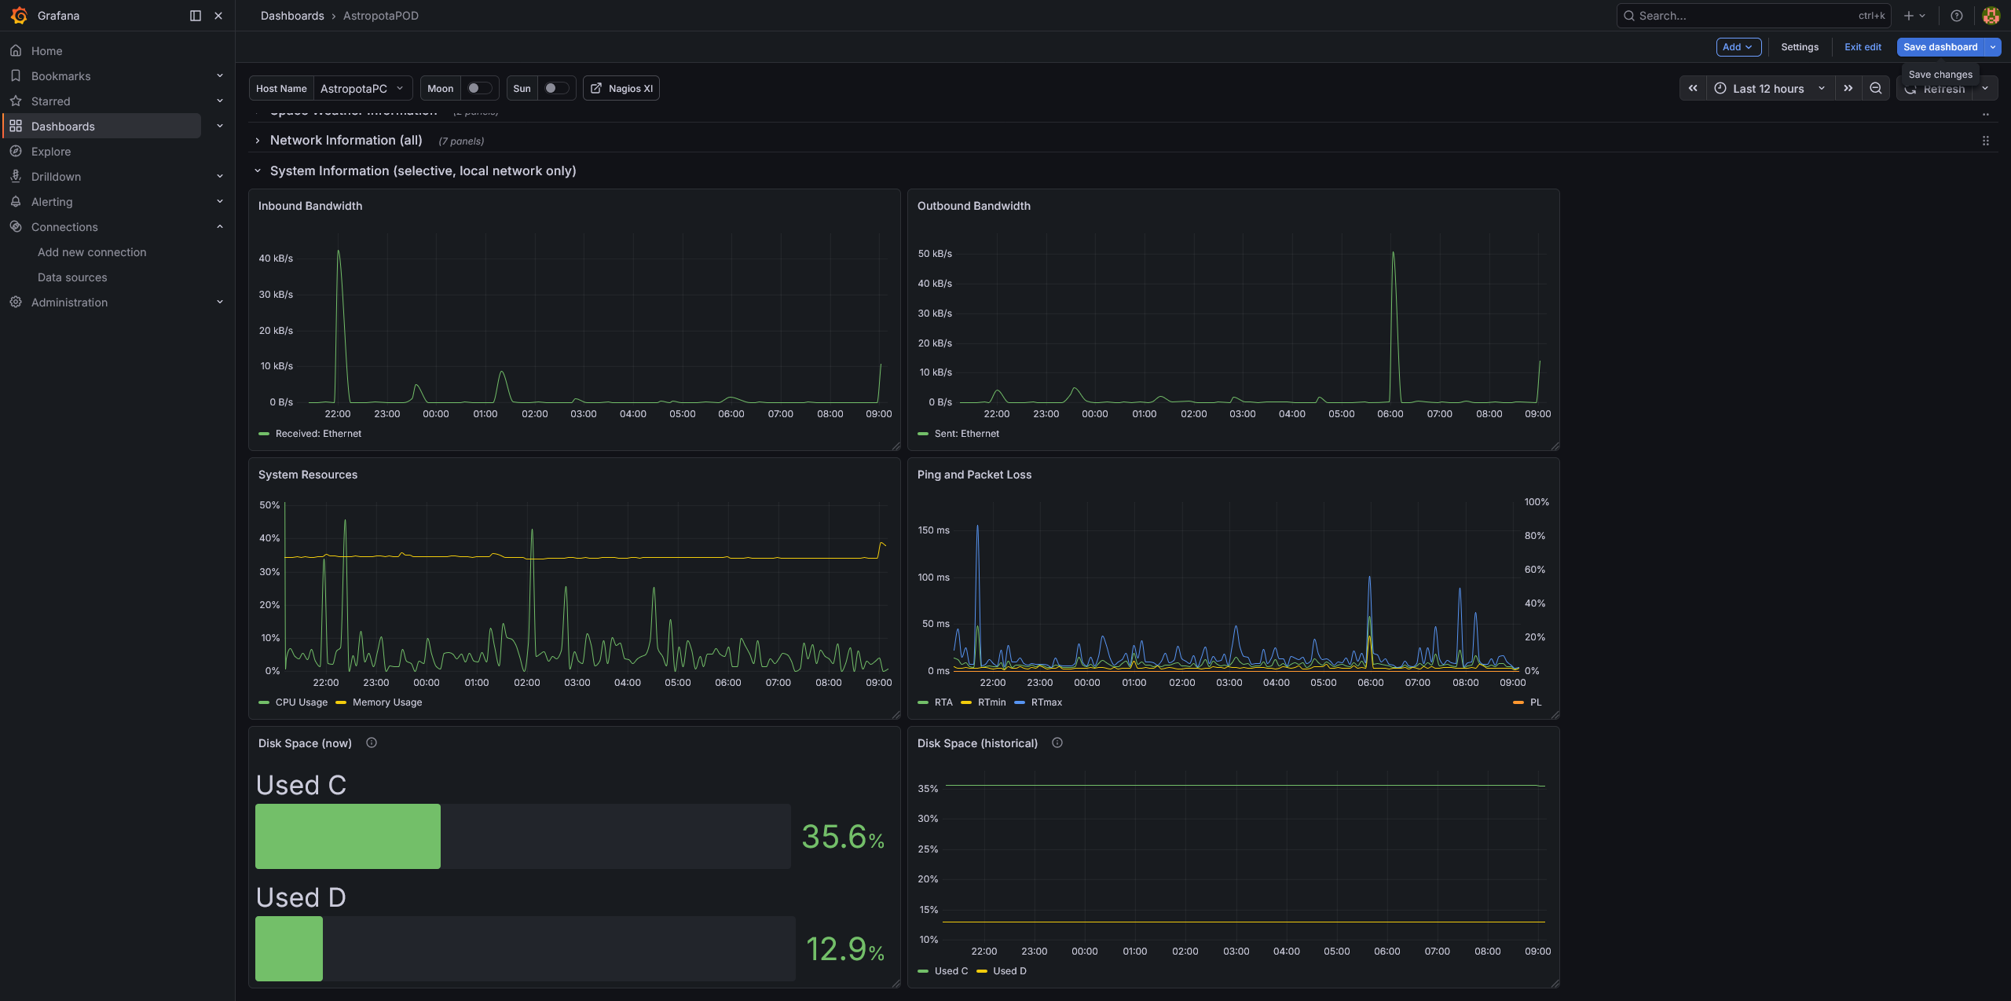

Slide 49


Slide 50
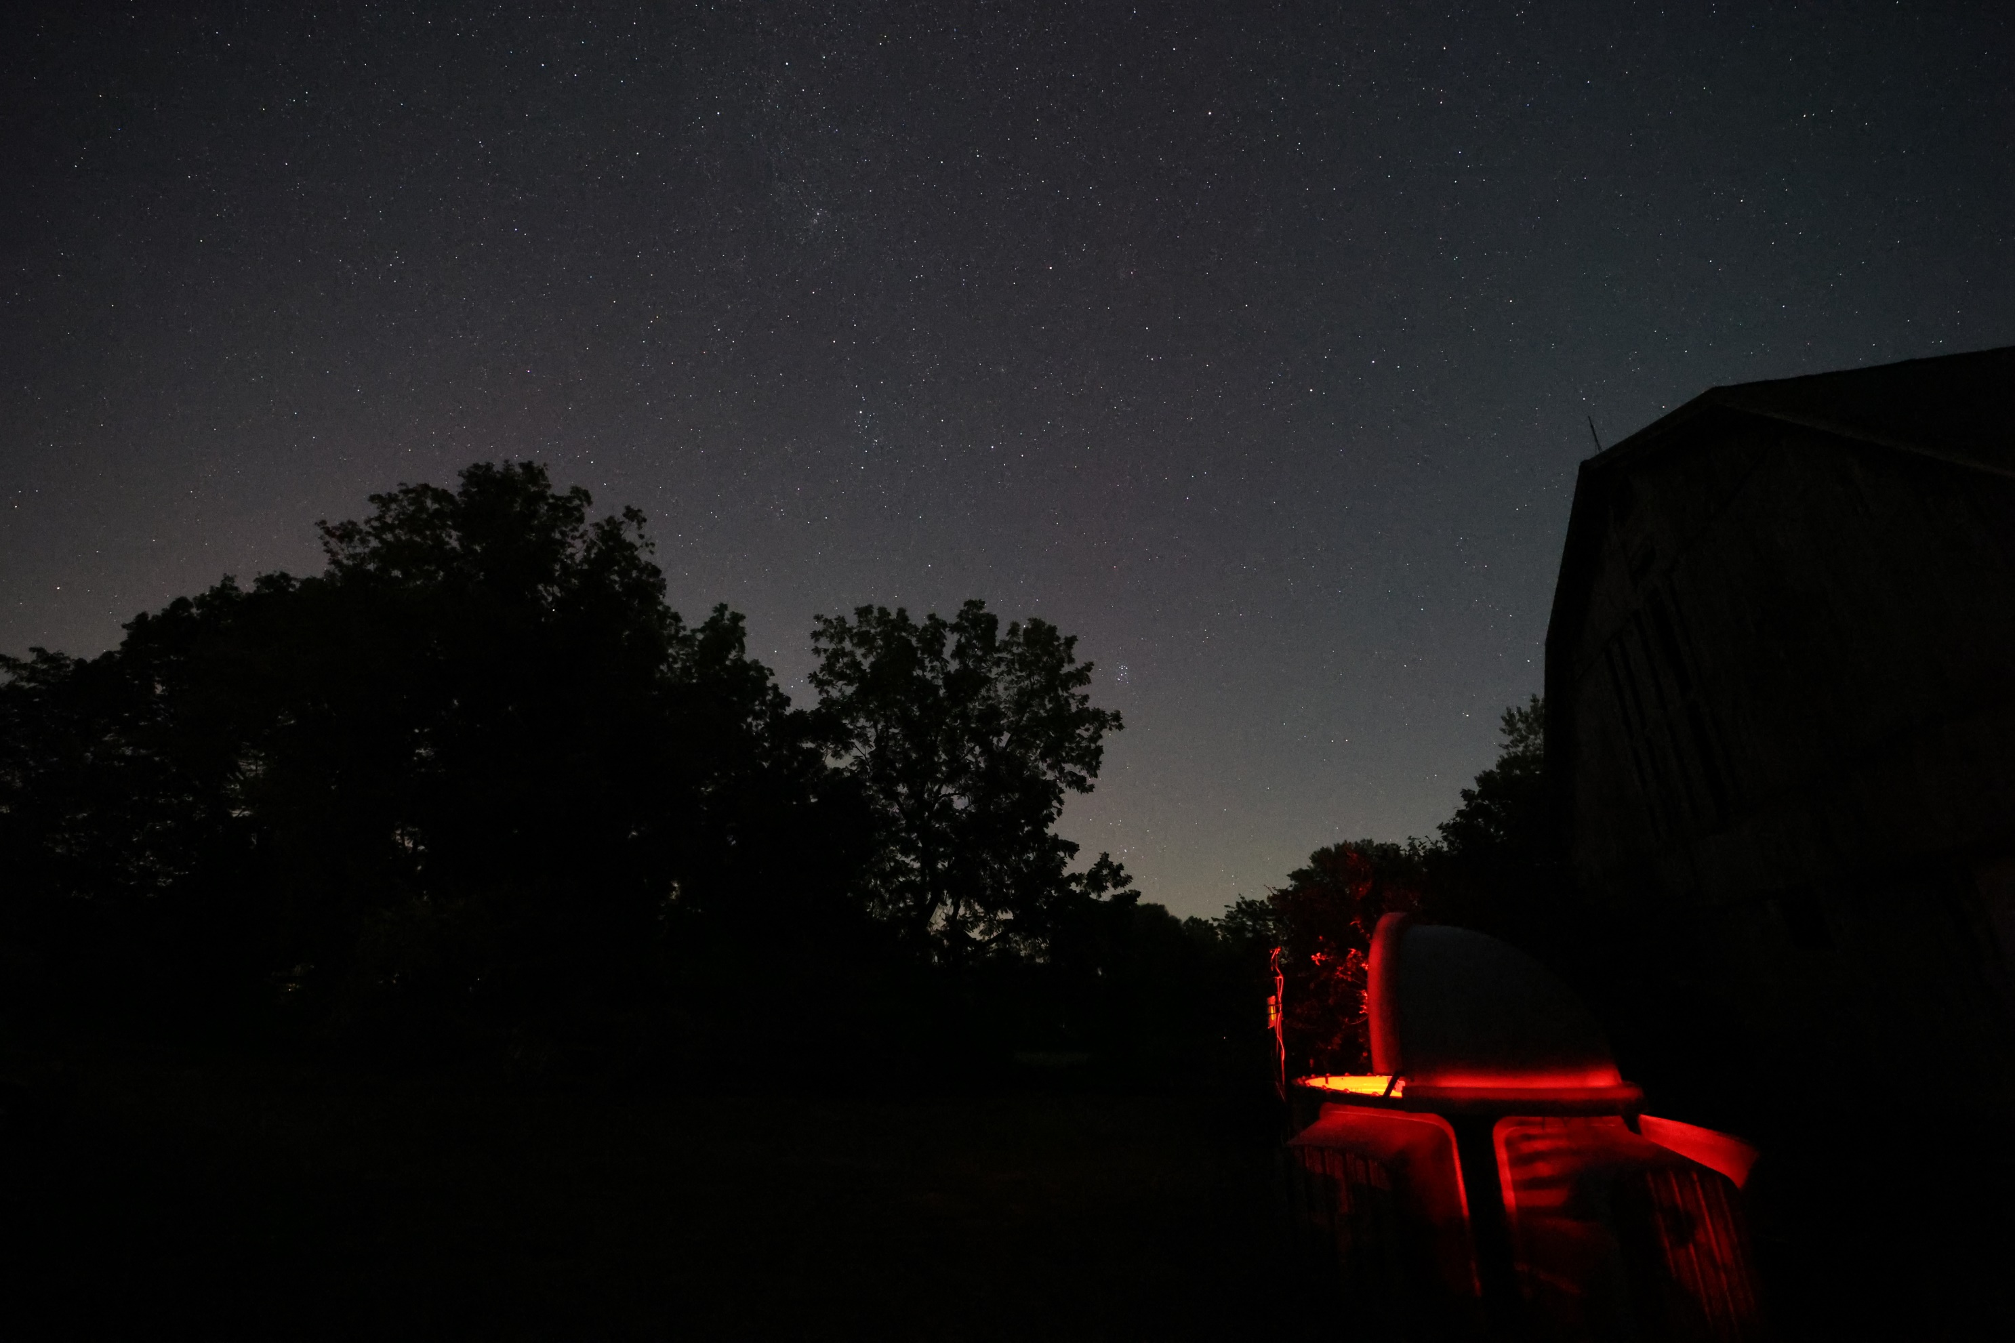

Questions?
https://astropotamus.com/nwc2026
Clear skies, and I’ll
see you in the dark!
Eric Loyd | The Astropotamus | https://astropotamus.com

