Slide 1
Summoning the Single Pane: A Live Nagios Fusion Ritual
(with giveaways!)
Eric Loyd | EverWatch Global | https://everwatch.global

Slide 2
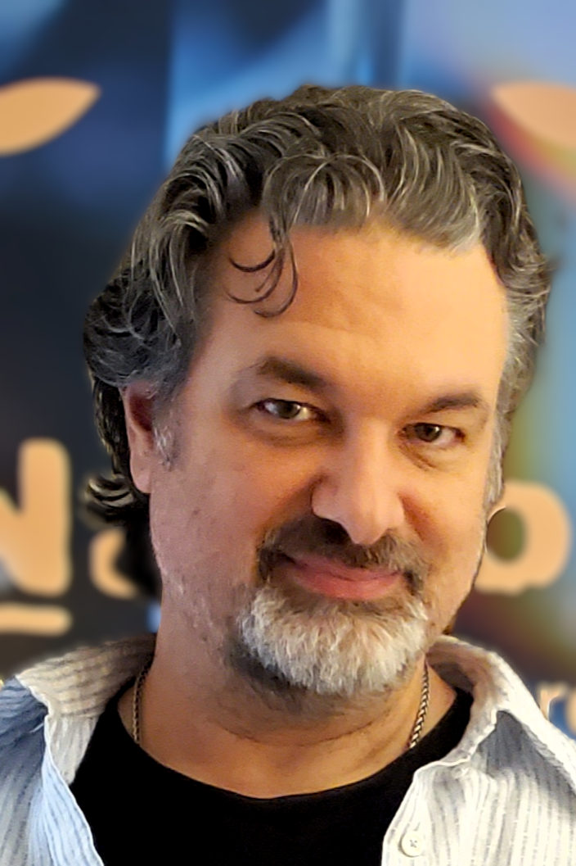
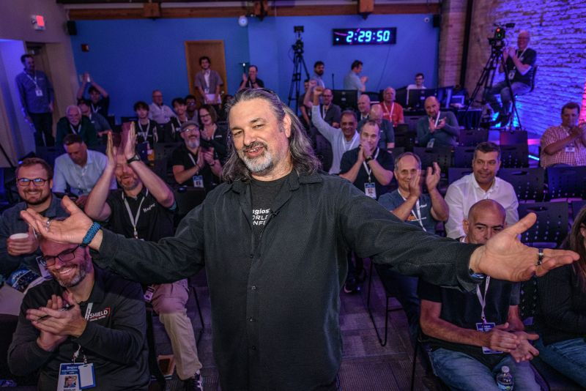
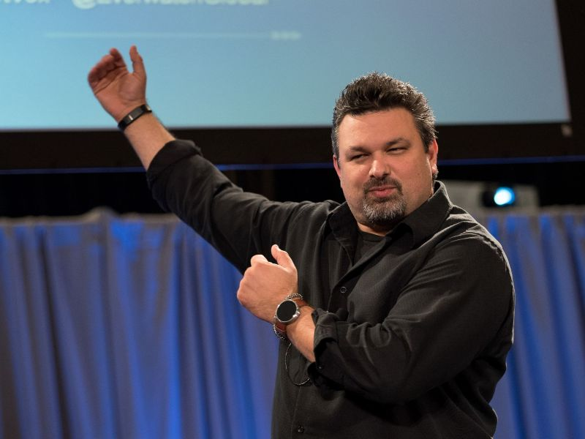
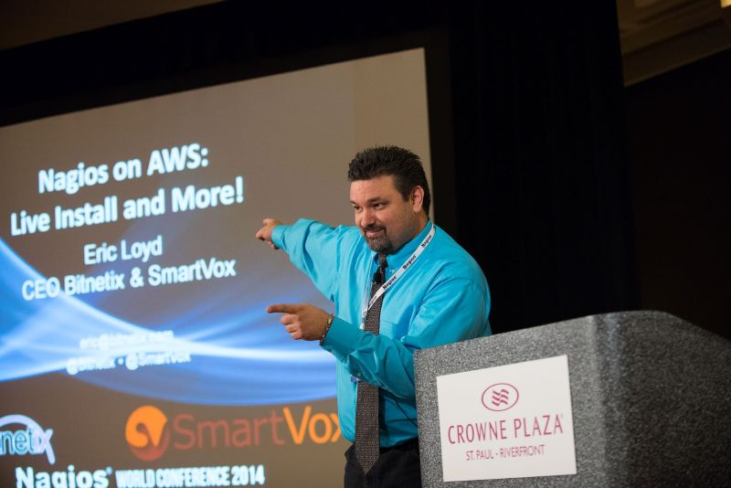
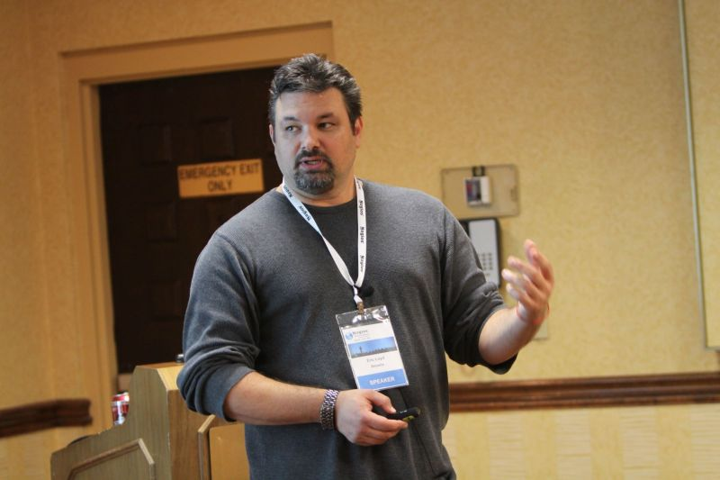
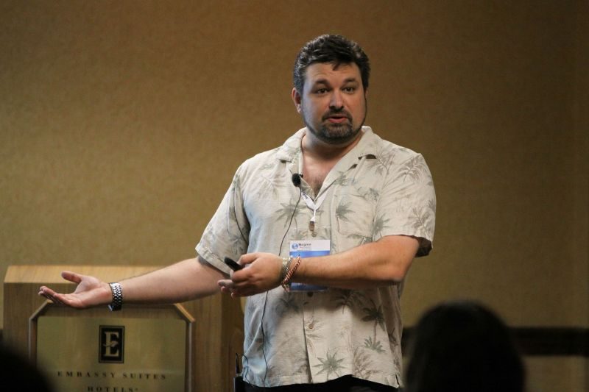
Eric’s Nagios Hair

Slide 3
Introduction to Nagios Fusion and how it works
OBSOLETE
Lots of new stuff added in 2026!

Slide 4
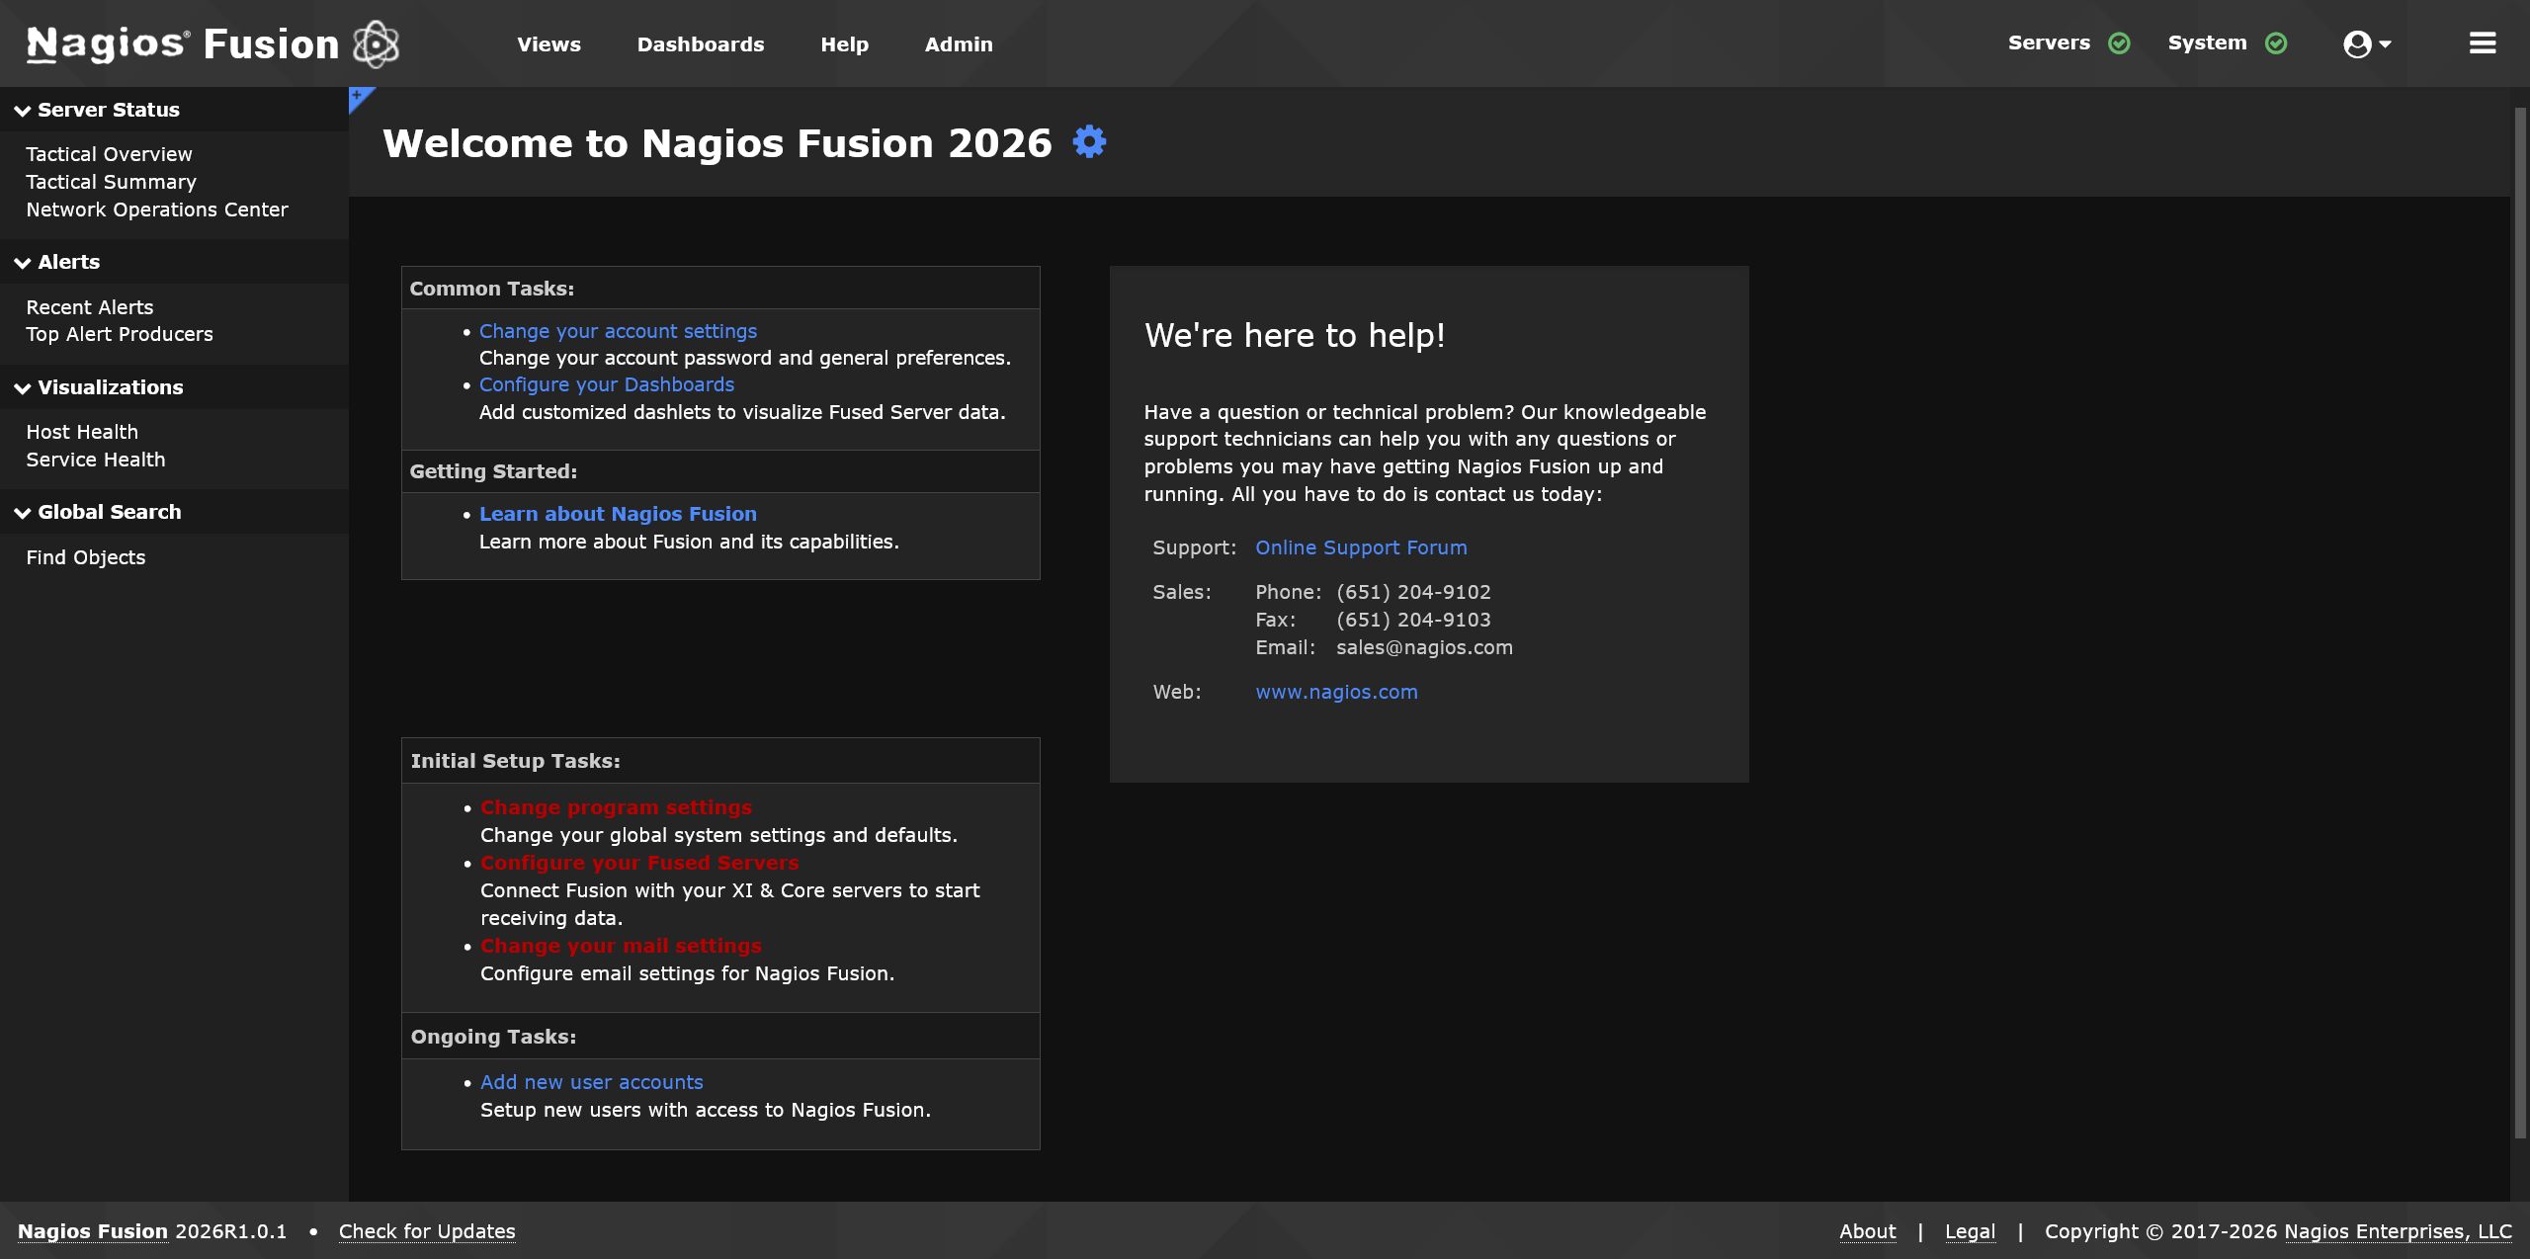

Slide 5
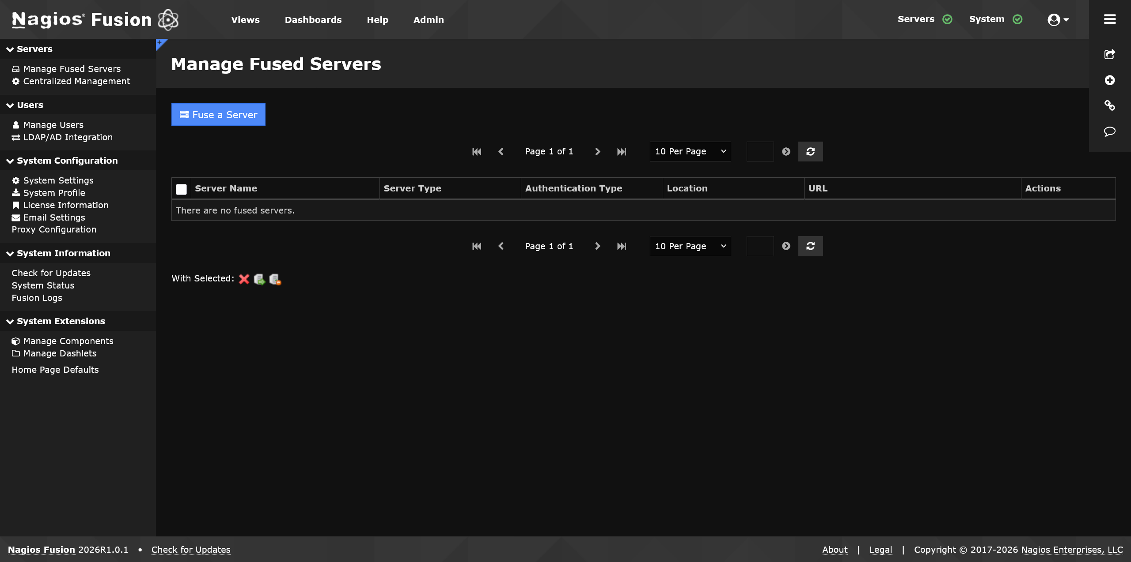

Slide 6
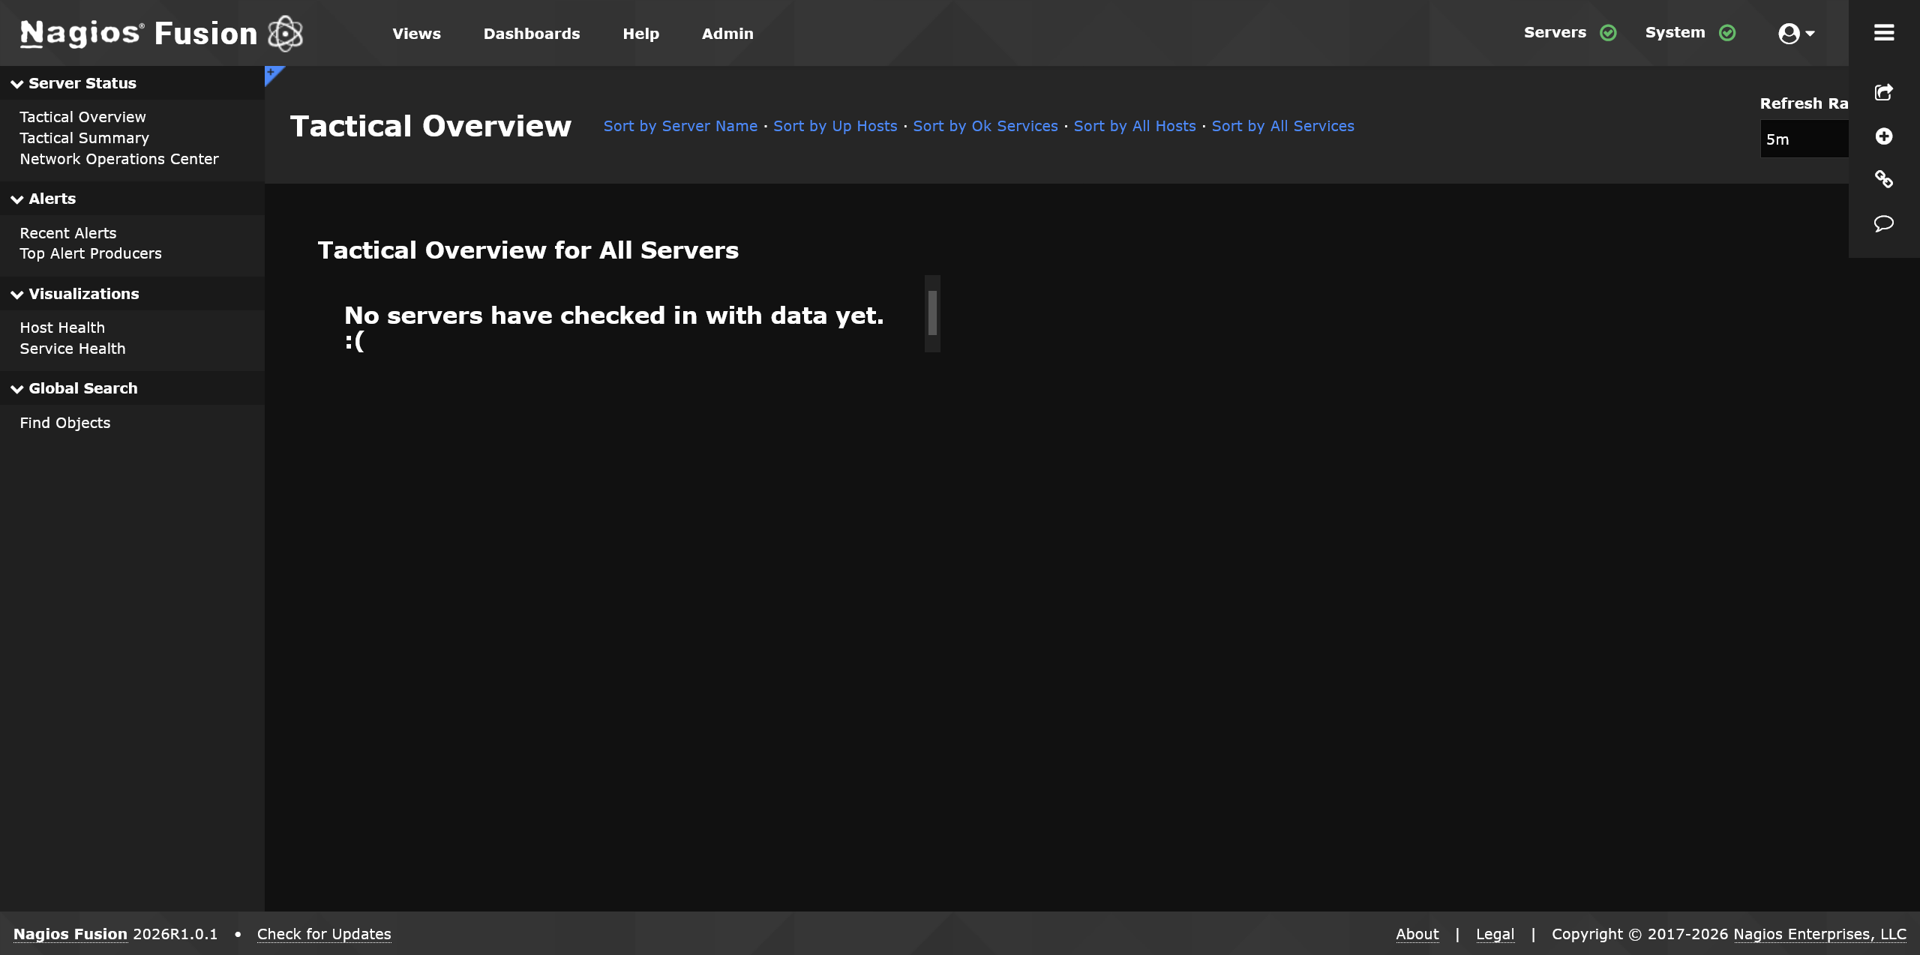

Slide 7
Let’s Fuse Some Shit
A handful of rPi Zeros will be used

Slide 8
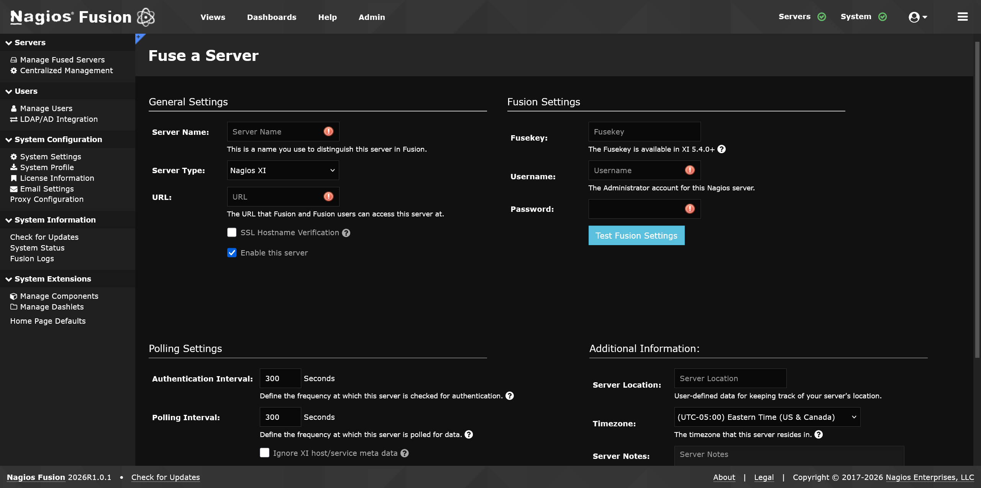

Slide 9
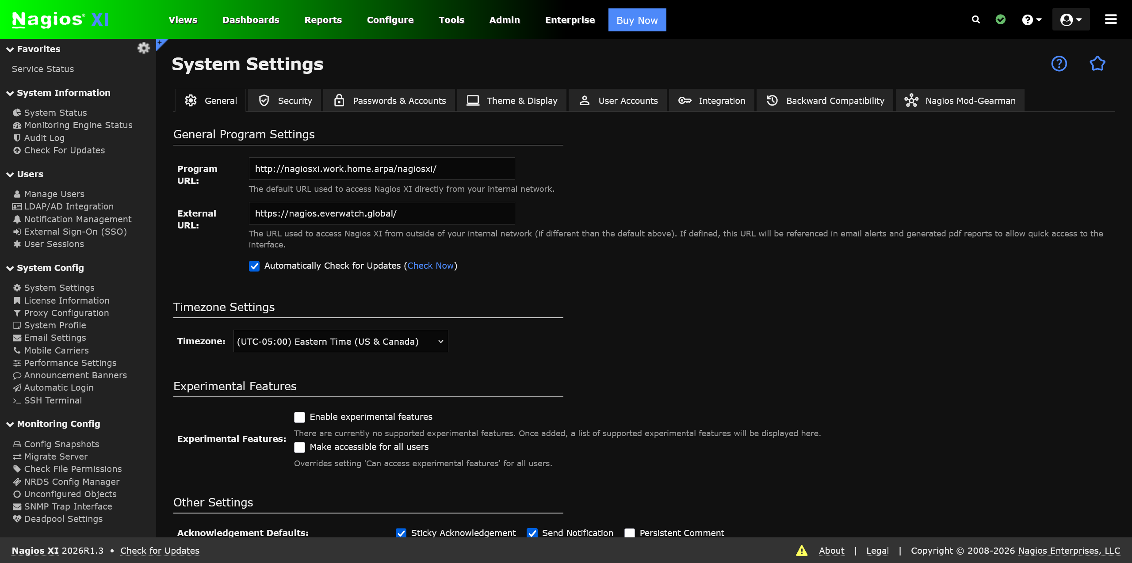

Slide 10
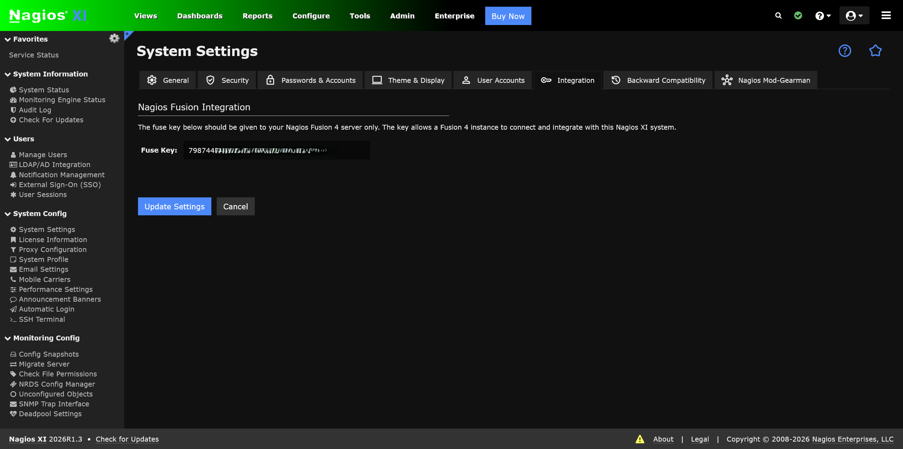

Slide 11
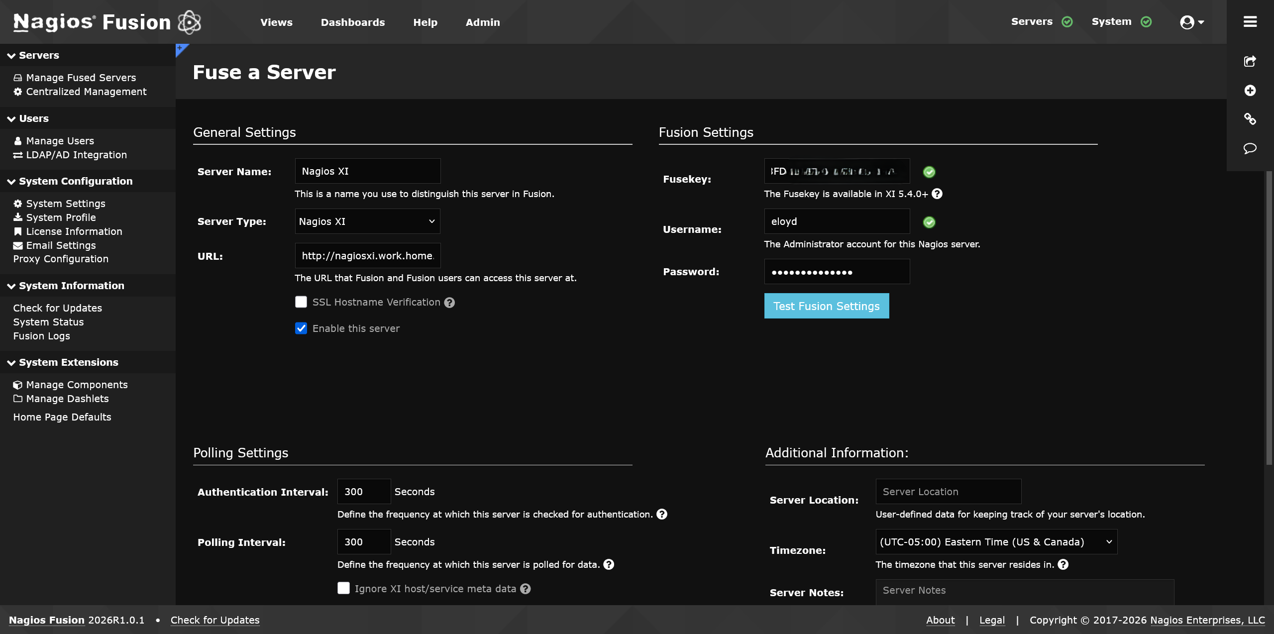

Slide 12
Technical Magic
Happens Here
How to fuse Core and XI

Slide 13
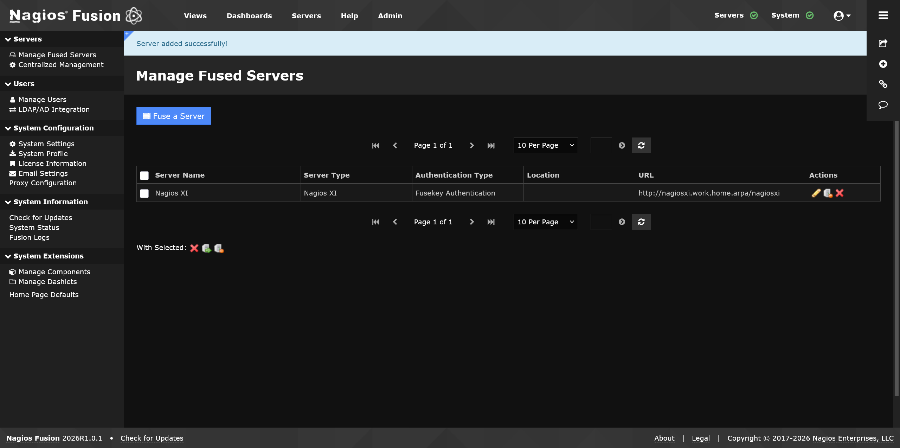

Slide 14
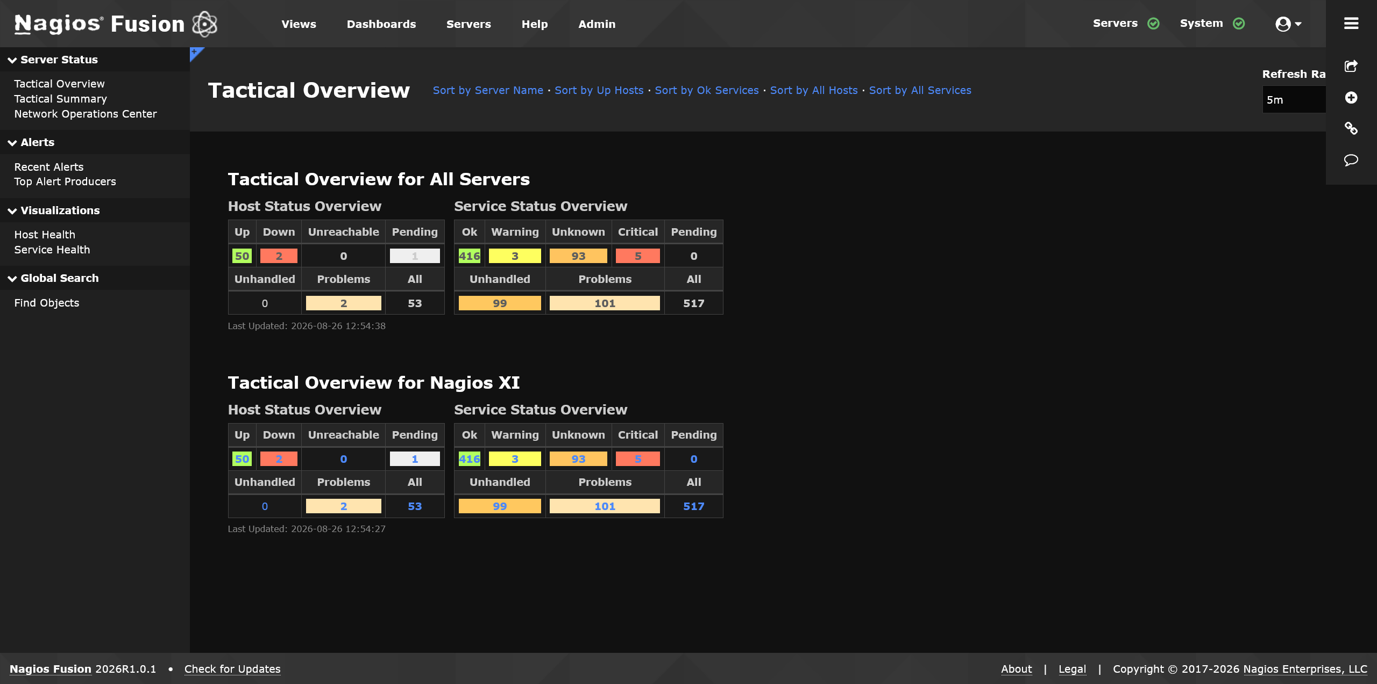

Slide 15
More Fun Stuff with Fusion
Spoiler Alert: It’s Dashboards.

Slide 16
Giveaways! https://everwatch.global/go/discord
Give away some stuff in a fair and orderly fashion

